Slide 1
异步编程
单线程 JavaScript 异步方案

Slide 2

线程

Slide 3
document.write('task 1')
document.write('task 2')
document.write('task 3')
document.write('task 4')
document.write('task 5')
线程

Slide 4
document.write('task 1')
document.write('task 2')
document.write('task 3')
document.write('task 4')
document.write('task 5')
线程

Slide 5
document.write('task 1')
document.write('task 2')
document.write('task 3')
document.write('task 4')
document.write('task 5')
线程

Slide 6
document.write('task 1')
document.write('task 2')
document.write('task 3')
document.write('task 4')
document.write('task 5')
线程

Slide 7
document.write('task 1')
document.write('task 2')
document.write('task 3')
document.write('task 4')
document.write('task 5')
线程

Slide 8
document.write('task 1')
document.write('task 2')
document.write('task 3')
document.write('task 4')
document.write('task 5')
线程

Slide 9
console.log('foo')
for (let i = 0; i < 100000; i++) {
console.log('耗时操作')
}
console.log('等待耗时操作结束')
线程

Slide 10
console.log('foo')
for (let i = 0; i < 100000; i++) {
console.log('耗时操作')
}
console.log('等待耗时操作结束')
线程

Slide 11
console.log('foo')
for (let i = 0; i < 100000; i++) {
console.log('耗时操作')
}
console.log('等待耗时操作结束')
线程

Slide 12
内容概要
同步模式与异步模式
事件循环与消息队列
异步编程的几种方式
Promise 异步方案、宏任务 / 微任务队列
Generator 异步方案、Async / Await 语法糖
SUMMARY

Slide 13
同步模式
Synchronous
Notes:
同步

Slide 14
console.log('global begin')
function bar () {
console.log('bar task')
}
function foo () {
console.log('foo task')
bar()
}
foo()
console.log('global end')

Slide 15
console.log('global begin')
function bar () {
console.log('bar task')
}
function foo () {
console.log('foo task')
bar()
}
foo()
console.log('global end')
Call stack
Console

Slide 16
console.log('global begin')
function bar () {
console.log('bar task')
}
function foo () {
console.log('foo task')
bar()
}
foo()
console.log('global end')
Call stack
Console

Slide 17
console.log('global begin')
function bar () {
console.log('bar task')
}
function foo () {
console.log('foo task')
bar()
}
foo()
console.log('global end')
Call stack
Console
(anonymous)

Slide 18
console.log('global begin')
function bar () {
console.log('bar task')
}
function foo () {
console.log('foo task')
bar()
}
foo()
console.log('global end')
Call stack
Console
(anonymous)

Slide 19
console.log('global begin')
function bar () {
console.log('bar task')
}
function foo () {
console.log('foo task')
bar()
}
foo()
console.log('global end')
Call stack
Console
console.log('global begin')
(anonymous)

Slide 20
console.log('global begin')
function bar () {
console.log('bar task')
}
function foo () {
console.log('foo task')
bar()
}
foo()
console.log('global end')
Call stack
Console
global begin
console.log('global begin')
(anonymous)

Slide 21
console.log('global begin')
function bar () {
console.log('bar task')
}
function foo () {
console.log('foo task')
bar()
}
foo()
console.log('global end')
Call stack
Console
global begin
(anonymous)

Slide 22
console.log('global begin')
function bar () {
console.log('bar task')
}
function foo () {
console.log('foo task')
bar()
}
foo()
console.log('global end')
Call stack
Console
global begin
(anonymous)

Slide 23
console.log('global begin')
function bar () {
console.log('bar task')
}
function foo () {
console.log('foo task')
bar()
}
foo()
console.log('global end')
Call stack
Console
global begin
(anonymous)

Slide 24
console.log('global begin')
function bar () {
console.log('bar task')
}
function foo () {
console.log('foo task')
bar()
}
foo()
console.log('global end')
Call stack
Console
global begin
(anonymous)

Slide 25
console.log('global begin')
function bar () {
console.log('bar task')
}
function foo () {
console.log('foo task')
bar()
}
foo()
console.log('global end')
Call stack
Console
global begin
foo()
(anonymous)

Slide 26
console.log('global begin')
function bar () {
console.log('bar task')
}
function foo () {
console.log('foo task')
bar()
}
foo()
console.log('global end')
Call stack
Console
global begin
foo()
(anonymous)

Slide 27
console.log('global begin')
function bar () {
console.log('bar task')
}
function foo () {
console.log('foo task')
bar()
}
foo()
console.log('global end')
Call stack
console.log('foo task')
Console
global begin
foo()
(anonymous)

Slide 28
console.log('global begin')
function bar () {
console.log('bar task')
}
function foo () {
console.log('foo task')
bar()
}
foo()
console.log('global end')
Call stack
console.log('foo task')
Console
global begin
foo()
foo task
(anonymous)

Slide 29
console.log('global begin')
function bar () {
console.log('bar task')
}
function foo () {
console.log('foo task')
bar()
}
foo()
console.log('global end')
Call stack
Console
global begin
foo()
foo task
(anonymous)

Slide 30
console.log('global begin')
function bar () {
console.log('bar task')
}
function foo () {
console.log('foo task')
bar()
}
foo()
console.log('global end')
Call stack
Console
global begin
foo()
foo task
(anonymous)

Slide 31
console.log('global begin')
function bar () {
console.log('bar task')
}
function foo () {
console.log('foo task')
bar()
}
foo()
console.log('global end')
Call stack
bar()
Console
global begin
foo()
foo task
(anonymous)

Slide 32
console.log('global begin')
function bar () {
console.log('bar task')
}
function foo () {
console.log('foo task')
bar()
}
foo()
console.log('global end')
Call stack
bar()
Console
global begin
foo()
foo task
(anonymous)

Slide 33
console.log('global begin')
function bar () {
console.log('bar task')
}
function foo () {
console.log('foo task')
bar()
}
foo()
console.log('global end')
Call stack
console.log('bar task')
bar()
Console
global begin
foo()
foo task
(anonymous)

Slide 34
console.log('global begin')
function bar () {
console.log('bar task')
}
function foo () {
console.log('foo task')
bar()
}
foo()
console.log('global end')
Call stack
console.log('bar task')
bar()
Console
global begin
foo()
foo task
bar task
(anonymous)

Slide 35
console.log('global begin')
function bar () {
console.log('bar task')
}
function foo () {
console.log('foo task')
bar()
}
foo()
console.log('global end')
Call stack
bar()
Console
global begin
foo()
foo task
bar task
(anonymous)

Slide 36
console.log('global begin')
function bar () {
console.log('bar task')
}
function foo () {
console.log('foo task')
bar()
}
foo()
console.log('global end')
Call stack
bar()
Console
global begin
foo()
foo task
bar task
(anonymous)

Slide 37
console.log('global begin')
function bar () {
console.log('bar task')
}
function foo () {
console.log('foo task')
bar()
}
foo()
console.log('global end')
Call stack
Console
global begin
foo()
foo task
bar task
(anonymous)

Slide 38
console.log('global begin')
function bar () {
console.log('bar task')
}
function foo () {
console.log('foo task')
bar()
}
foo()
console.log('global end')
Call stack
Console
global begin
foo()
foo task
bar task
(anonymous)

Slide 39
console.log('global begin')
function bar () {
console.log('bar task')
}
function foo () {
console.log('foo task')
bar()
}
foo()
console.log('global end')
Call stack
Console
global begin
foo task
bar task
(anonymous)

Slide 40
console.log('global begin')
function bar () {
console.log('bar task')
}
function foo () {
console.log('foo task')
bar()
}
foo()
console.log('global end')
Call stack
Console
global begin
foo task
bar task
(anonymous)

Slide 41
console.log('global begin')
function bar () {
console.log('bar task')
}
function foo () {
console.log('foo task')
bar()
}
foo()
console.log('global end')
Call stack
Console
global begin
console.log('global end')
foo task
bar task
(anonymous)

Slide 42
console.log('global begin')
function bar () {
console.log('bar task')
}
function foo () {
console.log('foo task')
bar()
}
foo()
console.log('global end')
Call stack
Console
global begin
console.log('global end')
foo task
bar task
(anonymous)
global end

Slide 43
console.log('global begin')
function bar () {
console.log('bar task')
}
function foo () {
console.log('foo task')
bar()
}
foo()
console.log('global end')
Call stack
Console
global begin
foo task
bar task
(anonymous)
global end

Slide 44
console.log('global begin')
function bar () {
console.log('bar task')
}
function foo () {
console.log('foo task')
bar()
}
foo()
console.log('global end')
Call stack
Console
global begin
foo task
bar task
(anonymous)
global end

Slide 45
console.log('global begin')
function bar () {
console.log('bar task')
}
function foo () {
console.log('foo task')
bar()
}
foo()
console.log('global end')
Call stack
Console
global begin
foo task
bar task
global end

Slide 46
异步模式
Asynchronous

Slide 47
console.log('global begin')
setTimeout(function timer1 () {
console.log('timer1 invoke')
}, 1800)
setTimeout(function timer2 () {
console.log('timer2 invoke')
setTimeout(function inner () {
console.log('inner invoke')
}, 1000)
}, 1000)
console.log('global end')

Slide 48
console.log('global begin')
setTimeout(function timer1 () {
console.log('timer1 invoke')
}, 1800)
setTimeout(function timer2 () {
console.log('timer2 invoke')
setTimeout(function inner () {
console.log('inner invoke')
}, 1000)
}, 1000)
console.log('global end')
Call stack
Web APIs
Console
Queue
Event loop

Slide 49
console.log('global begin')
setTimeout(function timer1 () {
console.log('timer1 invoke')
}, 1800)
setTimeout(function timer2 () {
console.log('timer2 invoke')
setTimeout(function inner () {
console.log('inner invoke')
}, 1000)
}, 1000)
console.log('global end')
Call stack
Web APIs
Console
Queue
Event loop

Slide 50
console.log('global begin')
setTimeout(function timer1 () {
console.log('timer1 invoke')
}, 1800)
setTimeout(function timer2 () {
console.log('timer2 invoke')
setTimeout(function inner () {
console.log('inner invoke')
}, 1000)
}, 1000)
console.log('global end')
Call stack
Web APIs
Console
(anonymous)
Queue
Event loop

Slide 51
console.log('global begin')
setTimeout(function timer1 () {
console.log('timer1 invoke')
}, 1800)
setTimeout(function timer2 () {
console.log('timer2 invoke')
setTimeout(function inner () {
console.log('inner invoke')
}, 1000)
}, 1000)
console.log('global end')
Call stack
Web APIs
Console
(anonymous)
Queue
Event loop

Slide 52
console.log('global begin')
setTimeout(function timer1 () {
console.log('timer1 invoke')
}, 1800)
setTimeout(function timer2 () {
console.log('timer2 invoke')
setTimeout(function inner () {
console.log('inner invoke')
}, 1000)
}, 1000)
console.log('global end')
Call stack
Web APIs
console.log()
Console
(anonymous)
Queue
Event loop

Slide 53
console.log('global begin')
setTimeout(function timer1 () {
console.log('timer1 invoke')
}, 1800)
setTimeout(function timer2 () {
console.log('timer2 invoke')
setTimeout(function inner () {
console.log('inner invoke')
}, 1000)
}, 1000)
console.log('global end')
Call stack
Web APIs
console.log()
Console
(anonymous)
global begin
Queue
Event loop

Slide 54
console.log('global begin')
setTimeout(function timer1 () {
console.log('timer1 invoke')
}, 1800)
setTimeout(function timer2 () {
console.log('timer2 invoke')
setTimeout(function inner () {
console.log('inner invoke')
}, 1000)
}, 1000)
console.log('global end')
Call stack
Web APIs
Console
(anonymous)
global begin
Queue
Event loop

Slide 55
console.log('global begin')
setTimeout(function timer1 () {
console.log('timer1 invoke')
}, 1800)
setTimeout(function timer2 () {
console.log('timer2 invoke')
setTimeout(function inner () {
console.log('inner invoke')
}, 1000)
}, 1000)
console.log('global end')
Call stack
Web APIs
Console
(anonymous)
global begin
Queue
Event loop

Slide 56
console.log('global begin')
setTimeout(function timer1 () {
console.log('timer1 invoke')
}, 1800)
setTimeout(function timer2 () {
console.log('timer2 invoke')
setTimeout(function inner () {
console.log('inner invoke')
}, 1000)
}, 1000)
console.log('global end')
Call stack
Web APIs
setTimeout(timer1)
Console
(anonymous)
global begin
Queue
Event loop

Slide 57
console.log('global begin')
setTimeout(function timer1 () {
console.log('timer1 invoke')
}, 1800)
setTimeout(function timer2 () {
console.log('timer2 invoke')
setTimeout(function inner () {
console.log('inner invoke')
}, 1000)
}, 1000)
console.log('global end')
Call stack
Web APIs
⏳ 1.8s timer1
setTimeout(timer1)
Console
(anonymous)
global begin
Queue
Event loop

Slide 58
console.log('global begin')
setTimeout(function timer1 () {
console.log('timer1 invoke')
}, 1800)
setTimeout(function timer2 () {
console.log('timer2 invoke')
setTimeout(function inner () {
console.log('inner invoke')
}, 1000)
}, 1000)
console.log('global end')
Call stack
Web APIs
⏳ 1.8s timer1
Console
(anonymous)
global begin
Queue
Event loop

Slide 59
console.log('global begin')
setTimeout(function timer1 () {
console.log('timer1 invoke')
}, 1800)
setTimeout(function timer2 () {
console.log('timer2 invoke')
setTimeout(function inner () {
console.log('inner invoke')
}, 1000)
}, 1000)
console.log('global end')
Call stack
Web APIs
⏳ 1.8s timer1
Console
(anonymous)
global begin
Queue
Event loop

Slide 60
console.log('global begin')
setTimeout(function timer1 () {
console.log('timer1 invoke')
}, 1800)
setTimeout(function timer2 () {
console.log('timer2 invoke')
setTimeout(function inner () {
console.log('inner invoke')
}, 1000)
}, 1000)
console.log('global end')
Call stack
Web APIs
⏳ 1.8s timer1
setTimeout(timer2)
Console
(anonymous)
global begin
Queue
Event loop

Slide 61
console.log('global begin')
setTimeout(function timer1 () {
console.log('timer1 invoke')
}, 1800)
setTimeout(function timer2 () {
console.log('timer2 invoke')
setTimeout(function inner () {
console.log('inner invoke')
}, 1000)
}, 1000)
console.log('global end')
Call stack
Web APIs
⏳ 1.8s timer1
⏳ 1s timer2
setTimeout(timer2)
Console
(anonymous)
global begin
Queue
Event loop

Slide 62
console.log('global begin')
setTimeout(function timer1 () {
console.log('timer1 invoke')
}, 1800)
setTimeout(function timer2 () {
console.log('timer2 invoke')
setTimeout(function inner () {
console.log('inner invoke')
}, 1000)
}, 1000)
console.log('global end')
Call stack
Web APIs
⏳ 1.8s timer1
⏳ 1s timer2
Console
(anonymous)
global begin
Queue
Event loop

Slide 63
console.log('global begin')
setTimeout(function timer1 () {
console.log('timer1 invoke')
}, 1800)
setTimeout(function timer2 () {
console.log('timer2 invoke')
setTimeout(function inner () {
console.log('inner invoke')
}, 1000)
}, 1000)
console.log('global end')
Call stack
Web APIs
⏳ 1.8s timer1
⏳ 1s timer2
Console
(anonymous)
global begin
Queue
Event loop

Slide 64
console.log('global begin')
setTimeout(function timer1 () {
console.log('timer1 invoke')
}, 1800)
setTimeout(function timer2 () {
console.log('timer2 invoke')
setTimeout(function inner () {
console.log('inner invoke')
}, 1000)
}, 1000)
console.log('global end')
Call stack
Web APIs
⏳ 1.8s timer1
⏳ 1s timer2
console.log()
Console
(anonymous)
global begin
Queue
Event loop

Slide 65
console.log('global begin')
setTimeout(function timer1 () {
console.log('timer1 invoke')
}, 1800)
setTimeout(function timer2 () {
console.log('timer2 invoke')
setTimeout(function inner () {
console.log('inner invoke')
}, 1000)
}, 1000)
console.log('global end')
Call stack
Web APIs
⏳ 1.8s timer1
⏳ 1s timer2
console.log()
Console
(anonymous)
global begin
global end
Queue
Event loop

Slide 66
console.log('global begin')
setTimeout(function timer1 () {
console.log('timer1 invoke')
}, 1800)
setTimeout(function timer2 () {
console.log('timer2 invoke')
setTimeout(function inner () {
console.log('inner invoke')
}, 1000)
}, 1000)
console.log('global end')
Call stack
Web APIs
⏳ 1.8s timer1
⏳ 1s timer2
Console
(anonymous)
global begin
global end
Queue
Event loop

Slide 67
console.log('global begin')
setTimeout(function timer1 () {
console.log('timer1 invoke')
}, 1800)
setTimeout(function timer2 () {
console.log('timer2 invoke')
setTimeout(function inner () {
console.log('inner invoke')
}, 1000)
}, 1000)
console.log('global end')
Call stack
Web APIs
⏳ 1.8s timer1
⏳ 1s timer2
Console
(anonymous)
global begin
global end
Queue
Event loop

Slide 68
console.log('global begin')
setTimeout(function timer1 () {
console.log('timer1 invoke')
}, 1800)
setTimeout(function timer2 () {
console.log('timer2 invoke')
setTimeout(function inner () {
console.log('inner invoke')
}, 1000)
}, 1000)
console.log('global end')
Call stack
Web APIs
⏳ 1.8s timer1
⏳ 1s timer2
Console
global begin
global end
Queue
Event loop

Slide 69
console.log('global begin')
setTimeout(function timer1 () {
console.log('timer1 invoke')
}, 1800)
setTimeout(function timer2 () {
console.log('timer2 invoke')
setTimeout(function inner () {
console.log('inner invoke')
}, 1000)
}, 1000)
console.log('global end')
Call stack
Web APIs
⏳ 1.8s timer1
⏳ 1s timer2
Console
global begin
global end
Queue
Event loop
timer2()
timer1()

Slide 70
console.log('global begin')
setTimeout(function timer1 () {
console.log('timer1 invoke')
}, 1800)
setTimeout(function timer2 () {
console.log('timer2 invoke')
setTimeout(function inner () {
console.log('inner invoke')
}, 1000)
}, 1000)
console.log('global end')
Call stack
Web APIs
Console
global begin
global end
Queue
Event loop
timer2()
timer1()

Slide 71
console.log('global begin')
setTimeout(function timer1 () {
console.log('timer1 invoke')
}, 1800)
setTimeout(function timer2 () {
console.log('timer2 invoke')
setTimeout(function inner () {
console.log('inner invoke')
}, 1000)
}, 1000)
console.log('global end')
Call stack
Web APIs
Console
timer2()
global begin
global end
Queue
Event loop
timer1()

Slide 72
console.log('global begin')
setTimeout(function timer1 () {
console.log('timer1 invoke')
}, 1800)
setTimeout(function timer2 () {
console.log('timer2 invoke')
setTimeout(function inner () {
console.log('inner invoke')
}, 1000)
}, 1000)
console.log('global end')
Call stack
Web APIs
Console
timer2()
global begin
global end
Queue
Event loop
timer1()

Slide 73
console.log('global begin')
setTimeout(function timer1 () {
console.log('timer1 invoke')
}, 1800)
setTimeout(function timer2 () {
console.log('timer2 invoke')
setTimeout(function inner () {
console.log('inner invoke')
}, 1000)
}, 1000)
console.log('global end')
Call stack
Web APIs
console.log()
Console
timer2()
global begin
global end
Queue
Event loop
timer1()

Slide 74
console.log('global begin')
setTimeout(function timer1 () {
console.log('timer1 invoke')
}, 1800)
setTimeout(function timer2 () {
console.log('timer2 invoke')
setTimeout(function inner () {
console.log('inner invoke')
}, 1000)
}, 1000)
console.log('global end')
Call stack
Web APIs
console.log()
Console
timer2()
global begin
global end
timer2 invoke
Queue
Event loop
timer1()

Slide 75
console.log('global begin')
setTimeout(function timer1 () {
console.log('timer1 invoke')
}, 1800)
setTimeout(function timer2 () {
console.log('timer2 invoke')
setTimeout(function inner () {
console.log('inner invoke')
}, 1000)
}, 1000)
console.log('global end')
Call stack
Web APIs
Console
timer2()
global begin
global end
timer2 invoke
Queue
Event loop
timer1()

Slide 76
console.log('global begin')
setTimeout(function timer1 () {
console.log('timer1 invoke')
}, 1800)
setTimeout(function timer2 () {
console.log('timer2 invoke')
setTimeout(function inner () {
console.log('inner invoke')
}, 1000)
}, 1000)
console.log('global end')
Call stack
Web APIs
Console
timer2()
global begin
global end
timer2 invoke
Queue
Event loop
timer1()

Slide 77
console.log('global begin')
setTimeout(function timer1 () {
console.log('timer1 invoke')
}, 1800)
setTimeout(function timer2 () {
console.log('timer2 invoke')
setTimeout(function inner () {
console.log('inner invoke')
}, 1000)
}, 1000)
console.log('global end')
Call stack
Web APIs
setTimeout(inner)
Console
timer2()
global begin
global end
timer2 invoke
Queue
Event loop
timer1()

Slide 78
console.log('global begin')
setTimeout(function timer1 () {
console.log('timer1 invoke')
}, 1800)
setTimeout(function timer2 () {
console.log('timer2 invoke')
setTimeout(function inner () {
console.log('inner invoke')
}, 1000)
}, 1000)
console.log('global end')
Call stack
Web APIs
⏳ 1s inner
setTimeout(inner)
Console
timer2()
global begin
global end
timer2 invoke
Queue
Event loop
timer1()

Slide 79
console.log('global begin')
setTimeout(function timer1 () {
console.log('timer1 invoke')
}, 1800)
setTimeout(function timer2 () {
console.log('timer2 invoke')
setTimeout(function inner () {
console.log('inner invoke')
}, 1000)
}, 1000)
console.log('global end')
Call stack
Web APIs
⏳ 1s inner
Console
timer2()
global begin
global end
timer2 invoke
Queue
Event loop
timer1()

Slide 80
console.log('global begin')
setTimeout(function timer1 () {
console.log('timer1 invoke')
}, 1800)
setTimeout(function timer2 () {
console.log('timer2 invoke')
setTimeout(function inner () {
console.log('inner invoke')
}, 1000)
}, 1000)
console.log('global end')
Call stack
Web APIs
⏳ 1s inner
Console
timer2()
global begin
global end
timer2 invoke
Queue
Event loop
timer1()

Slide 81
console.log('global begin')
setTimeout(function timer1 () {
console.log('timer1 invoke')
}, 1800)
setTimeout(function timer2 () {
console.log('timer2 invoke')
setTimeout(function inner () {
console.log('inner invoke')
}, 1000)
}, 1000)
console.log('global end')
Call stack
Web APIs
⏳ 1s inner
Console
global begin
global end
timer2 invoke
Queue
Event loop
timer1()

Slide 82
console.log('global begin')
setTimeout(function timer1 () {
console.log('timer1 invoke')
}, 1800)
setTimeout(function timer2 () {
console.log('timer2 invoke')
setTimeout(function inner () {
console.log('inner invoke')
}, 1000)
}, 1000)
console.log('global end')
Call stack
Web APIs
⏳ 1s inner
Console
global begin
global end
timer2 invoke
Queue
Event loop
timer1()

Slide 83
console.log('global begin')
setTimeout(function timer1 () {
console.log('timer1 invoke')
}, 1800)
setTimeout(function timer2 () {
console.log('timer2 invoke')
setTimeout(function inner () {
console.log('inner invoke')
}, 1000)
}, 1000)
console.log('global end')
Call stack
Web APIs
⏳ 1s inner
Console
timer1()
global begin
global end
timer2 invoke
Queue
Event loop

Slide 84
console.log('global begin')
setTimeout(function timer1 () {
console.log('timer1 invoke')
}, 1800)
setTimeout(function timer2 () {
console.log('timer2 invoke')
setTimeout(function inner () {
console.log('inner invoke')
}, 1000)
}, 1000)
console.log('global end')
Call stack
Web APIs
⏳ 1s inner
Console
timer1()
global begin
global end
timer2 invoke
Queue
Event loop

Slide 85
console.log('global begin')
setTimeout(function timer1 () {
console.log('timer1 invoke')
}, 1800)
setTimeout(function timer2 () {
console.log('timer2 invoke')
setTimeout(function inner () {
console.log('inner invoke')
}, 1000)
}, 1000)
console.log('global end')
Call stack
Web APIs
⏳ 1s inner
console.log()
Console
timer1()
global begin
global end
timer2 invoke
Queue
Event loop

Slide 86
console.log('global begin')
setTimeout(function timer1 () {
console.log('timer1 invoke')
}, 1800)
setTimeout(function timer2 () {
console.log('timer2 invoke')
setTimeout(function inner () {
console.log('inner invoke')
}, 1000)
}, 1000)
console.log('global end')
Call stack
Web APIs
⏳ 1s inner
console.log()
Console
timer1()
global begin
global end
timer2 invoke
Queue
Event loop
timer1 invoke

Slide 87
console.log('global begin')
setTimeout(function timer1 () {
console.log('timer1 invoke')
}, 1800)
setTimeout(function timer2 () {
console.log('timer2 invoke')
setTimeout(function inner () {
console.log('inner invoke')
}, 1000)
}, 1000)
console.log('global end')
Call stack
Web APIs
⏳ 1s inner
Console
timer1()
global begin
global end
timer2 invoke
Queue
Event loop
timer1 invoke

Slide 88
console.log('global begin')
setTimeout(function timer1 () {
console.log('timer1 invoke')
}, 1800)
setTimeout(function timer2 () {
console.log('timer2 invoke')
setTimeout(function inner () {
console.log('inner invoke')
}, 1000)
}, 1000)
console.log('global end')
Call stack
Web APIs
⏳ 1s inner
Console
timer1()
global begin
global end
timer2 invoke
Queue
Event loop
timer1 invoke

Slide 89
console.log('global begin')
setTimeout(function timer1 () {
console.log('timer1 invoke')
}, 1800)
setTimeout(function timer2 () {
console.log('timer2 invoke')
setTimeout(function inner () {
console.log('inner invoke')
}, 1000)
}, 1000)
console.log('global end')
Call stack
Web APIs
⏳ 1s inner
Console
global begin
global end
timer2 invoke
Queue
Event loop
timer1 invoke

Slide 90
console.log('global begin')
setTimeout(function timer1 () {
console.log('timer1 invoke')
}, 1800)
setTimeout(function timer2 () {
console.log('timer2 invoke')
setTimeout(function inner () {
console.log('inner invoke')
}, 1000)
}, 1000)
console.log('global end')
Call stack
Web APIs
⏳ 1s inner
Console
global begin
global end
timer2 invoke
Queue
Event loop
timer1 invoke
inner()

Slide 91
console.log('global begin')
setTimeout(function timer1 () {
console.log('timer1 invoke')
}, 1800)
setTimeout(function timer2 () {
console.log('timer2 invoke')
setTimeout(function inner () {
console.log('inner invoke')
}, 1000)
}, 1000)
console.log('global end')
Call stack
Web APIs
Console
global begin
global end
timer2 invoke
Queue
Event loop
timer1 invoke
inner()

Slide 92
console.log('global begin')
setTimeout(function timer1 () {
console.log('timer1 invoke')
}, 1800)
setTimeout(function timer2 () {
console.log('timer2 invoke')
setTimeout(function inner () {
console.log('inner invoke')
}, 1000)
}, 1000)
console.log('global end')
Call stack
Web APIs
Console
inner()
global begin
global end
timer2 invoke
Queue
Event loop
timer1 invoke

Slide 93
console.log('global begin')
setTimeout(function timer1 () {
console.log('timer1 invoke')
}, 1800)
setTimeout(function timer2 () {
console.log('timer2 invoke')
setTimeout(function inner () {
console.log('inner invoke')
}, 1000)
}, 1000)
console.log('global end')
Call stack
Web APIs
Console
inner()
global begin
global end
timer2 invoke
Queue
Event loop
timer1 invoke

Slide 94
console.log('global begin')
setTimeout(function timer1 () {
console.log('timer1 invoke')
}, 1800)
setTimeout(function timer2 () {
console.log('timer2 invoke')
setTimeout(function inner () {
console.log('inner invoke')
}, 1000)
}, 1000)
console.log('global end')
Call stack
Web APIs
console.log()
Console
inner()
global begin
global end
timer2 invoke
Queue
Event loop
timer1 invoke

Slide 95
console.log('global begin')
setTimeout(function timer1 () {
console.log('timer1 invoke')
}, 1800)
setTimeout(function timer2 () {
console.log('timer2 invoke')
setTimeout(function inner () {
console.log('inner invoke')
}, 1000)
}, 1000)
console.log('global end')
Call stack
Web APIs
console.log()
Console
inner()
global begin
global end
timer2 invoke
Queue
Event loop
timer1 invoke
inner invoke

Slide 96
console.log('global begin')
setTimeout(function timer1 () {
console.log('timer1 invoke')
}, 1800)
setTimeout(function timer2 () {
console.log('timer2 invoke')
setTimeout(function inner () {
console.log('inner invoke')
}, 1000)
}, 1000)
console.log('global end')
Call stack
Web APIs
Console
inner()
global begin
global end
timer2 invoke
Queue
Event loop
timer1 invoke
inner invoke

Slide 97
console.log('global begin')
setTimeout(function timer1 () {
console.log('timer1 invoke')
}, 1800)
setTimeout(function timer2 () {
console.log('timer2 invoke')
setTimeout(function inner () {
console.log('inner invoke')
}, 1000)
}, 1000)
console.log('global end')
Call stack
Web APIs
Console
inner()
global begin
global end
timer2 invoke
Queue
Event loop
timer1 invoke
inner invoke

Slide 98
console.log('global begin')
setTimeout(function timer1 () {
console.log('timer1 invoke')
}, 1800)
setTimeout(function timer2 () {
console.log('timer2 invoke')
setTimeout(function inner () {
console.log('inner invoke')
}, 1000)
}, 1000)
console.log('global end')
Call stack
Web APIs
Console
global begin
global end
timer2 invoke
Queue
Event loop
timer1 invoke
inner invoke

Slide 99
执行本轮其它任务
执行回调
JavaScript 线程
发起异步调用
消息队列
回调 1
回调 2
回调 3
回调 4
回调 5
异步回调排队
异步调用线程
执行异步任务

Slide 100
回调函数
所有异步编程方案的根基

Slide 101
想给桌子重新刷漆

Slide 102
知道该怎么刷

Slide 103
没有油漆

Slide 104
找你帮我买桶漆

Slide 105
怎么刷漆
找你帮我买桶漆

Slide 106
怎么刷漆
函数
找你帮我买桶漆
调用
调用者
执行者

Slide 107
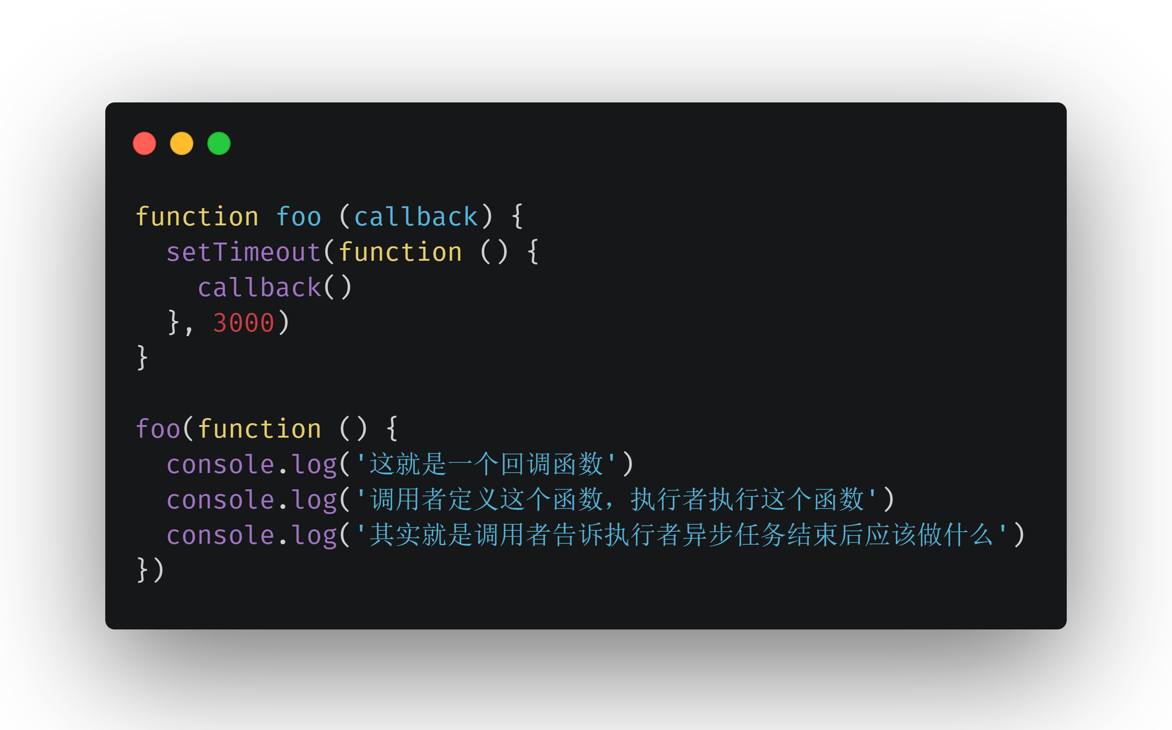

Slide 108
Promise
一种更优的异步编程统一方案

Slide 109
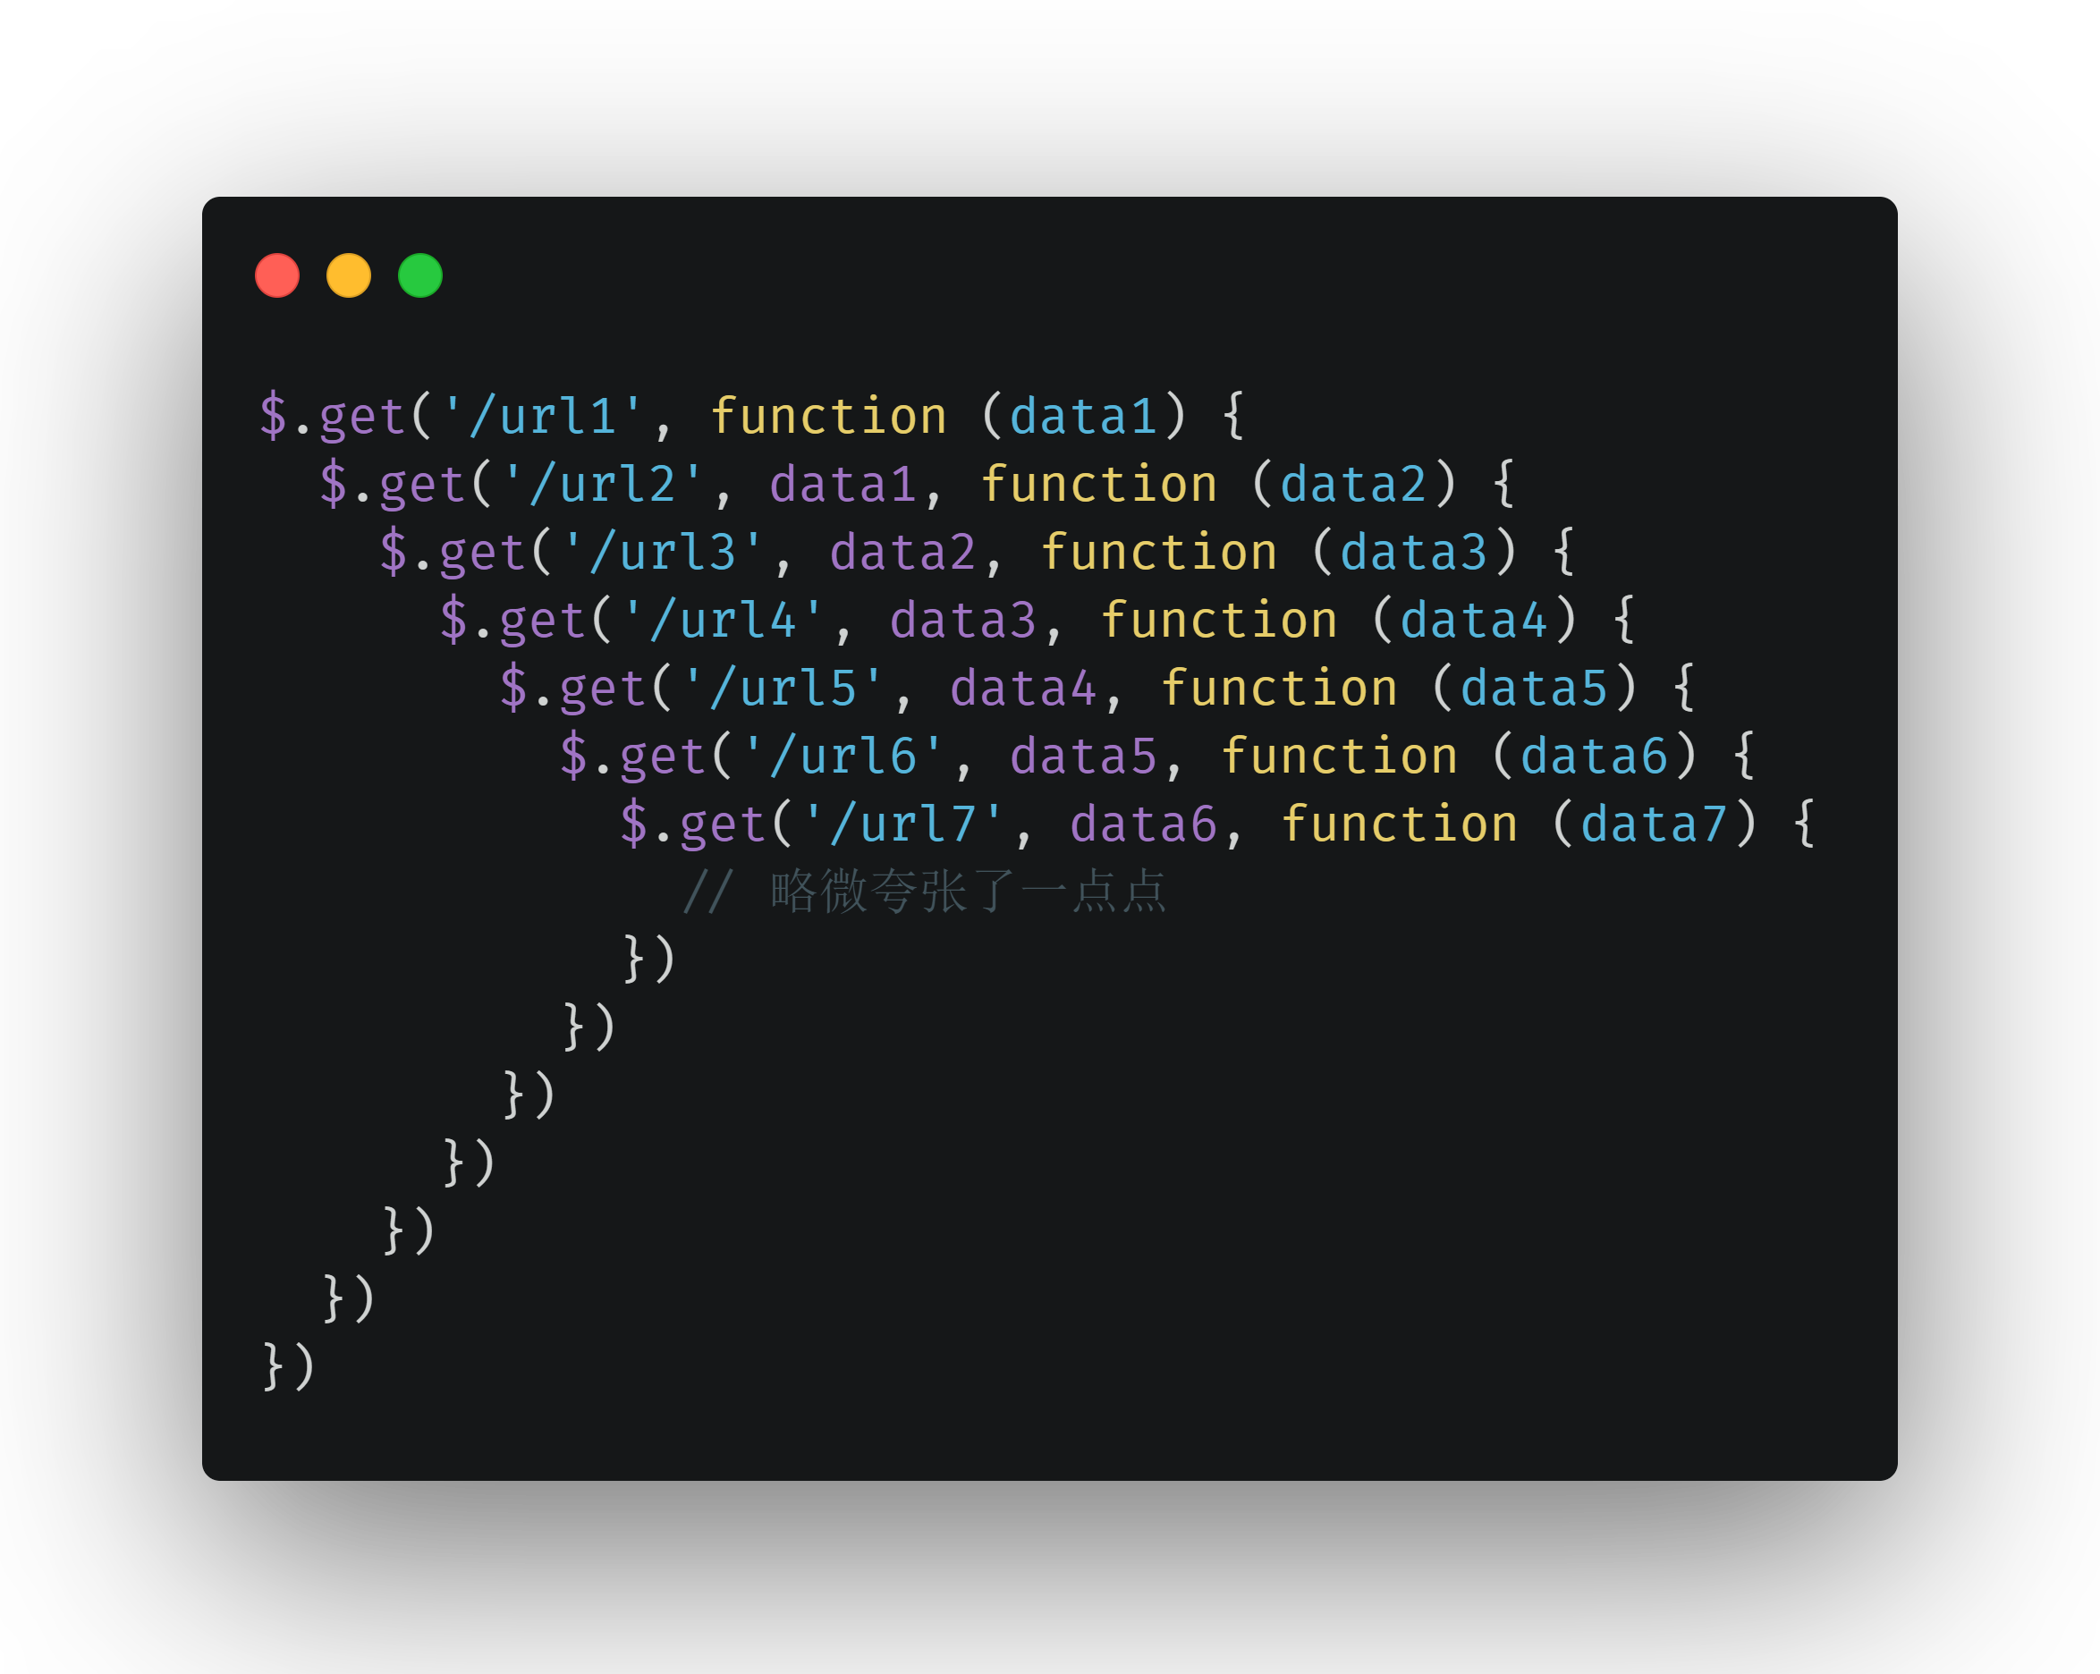

Slide 110
Promise
Notes:
commJS社区，ECAMscript2015中 被加入到规范当中
异步任务对外界的承诺

Slide 111
Promise
Pending
Notes:
承诺结果待定 Pending

Slide 112
Fulfilled
Promise
Pending

Slide 113
Fulfilled
Promise
Pending
Rejected
Notes:
结果成功 fulfilled
失败 Rejected

Slide 114
Fulfilled
onFulfilled
Promise
Pending
Rejected
onRejected
Notes:
对于结果的反应
onFulfilled 成功
onRejected 失败
一旦有结果，不可能再更改；

Slide 115
Promise
基本用法

Slide 116
Promise
使用案例

Slide 117
Promise
常见误区

Slide 118
Promise
链式调用

Slide 119
Promise
异常处理

Slide 120
Generator 异步方案
回顾 Generator 函数

Slide 121
Generator 异步方案
体验 Generator 函数异步方案

Slide 122
Generator 异步方案
递归执行 Generator 函数

Slide 123
Async / Await 语法糖
语言层面的异步编程标准

Slide 124
资深前端工程师培养计划
在职前端人的职场跳板
设立背景
前端技术变革日新月异
知其然并不知其所以然
持续学习的必要性
高质量系统化提升产品稀缺
核心目标
帮助前端人短时间内突破瓶颈
更深层次的技术理解与运用
更宽范围的技术应用领域
更多的行业场景踩坑经验

Slide 125
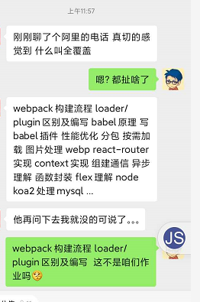
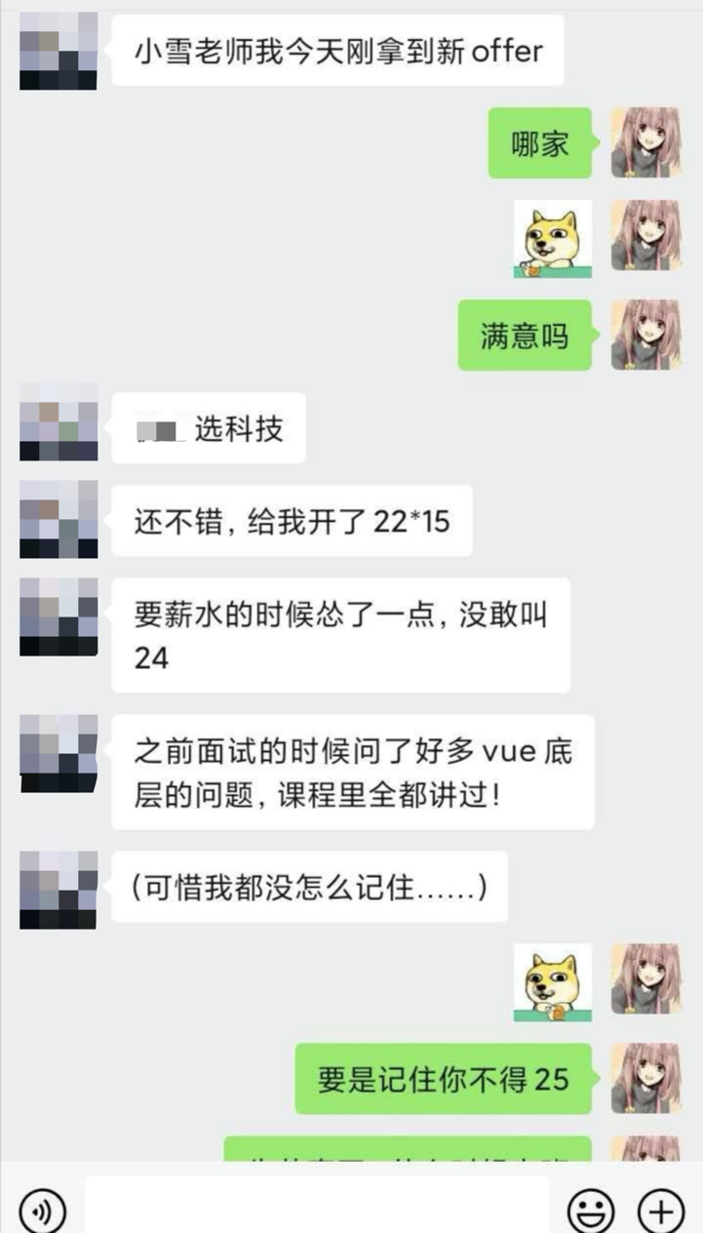
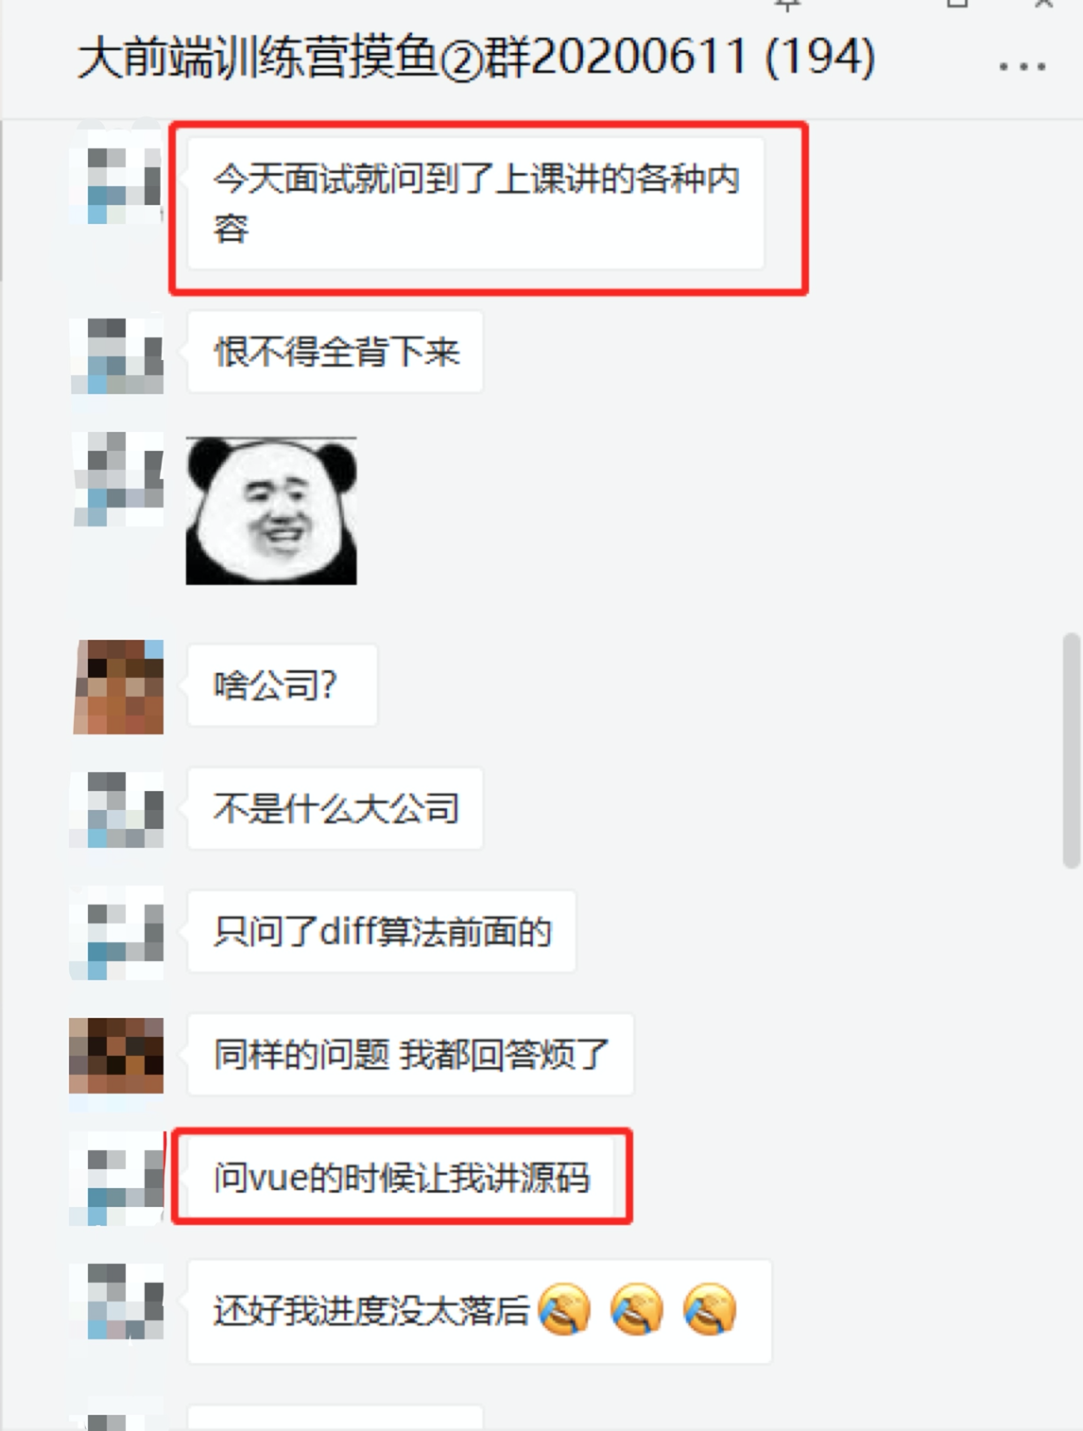
面试皆为所学，工作皆为所练

Slide 126
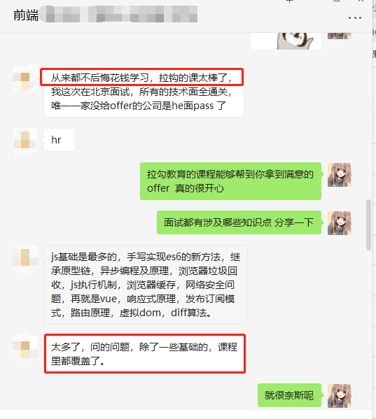
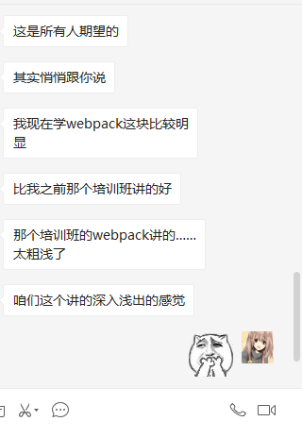
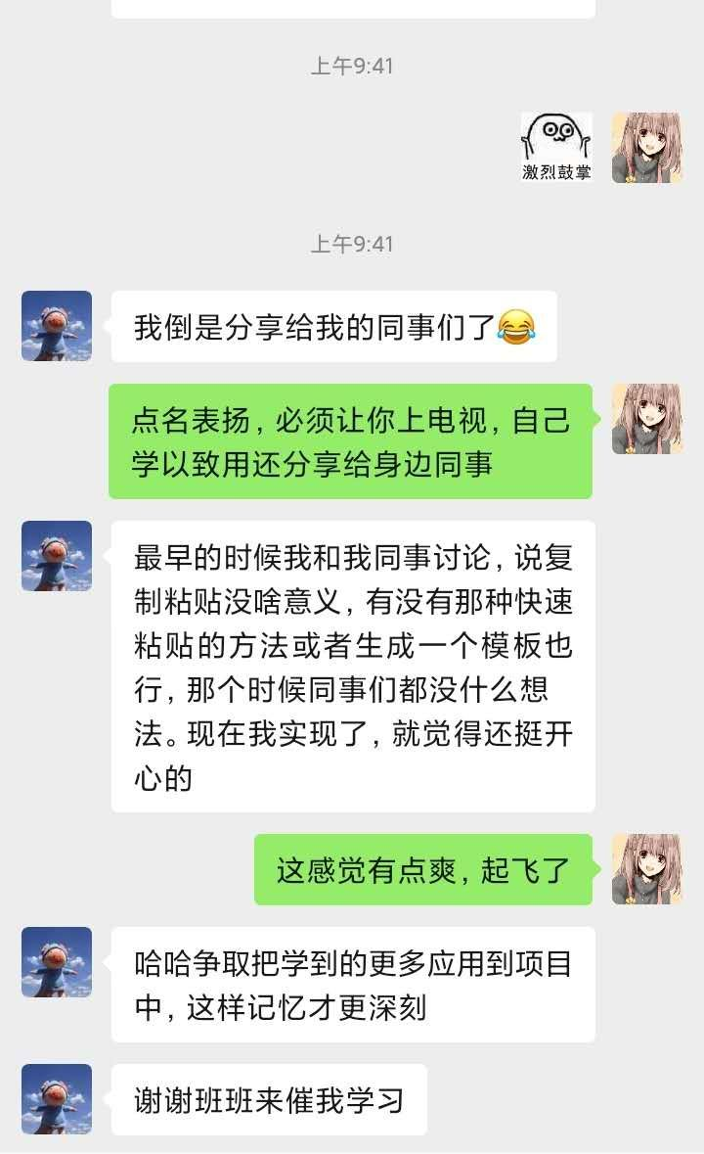
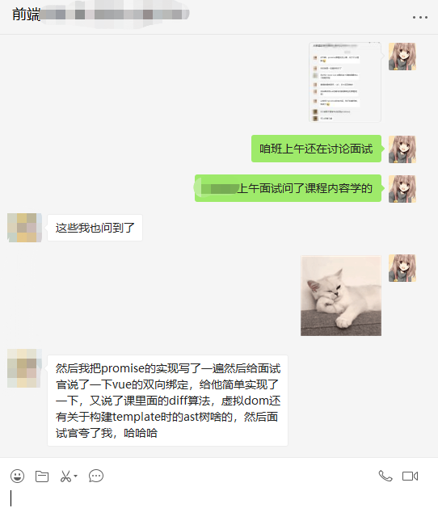
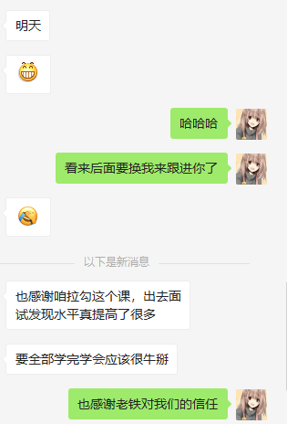
面试皆为所学，工作皆为所练

Slide 127

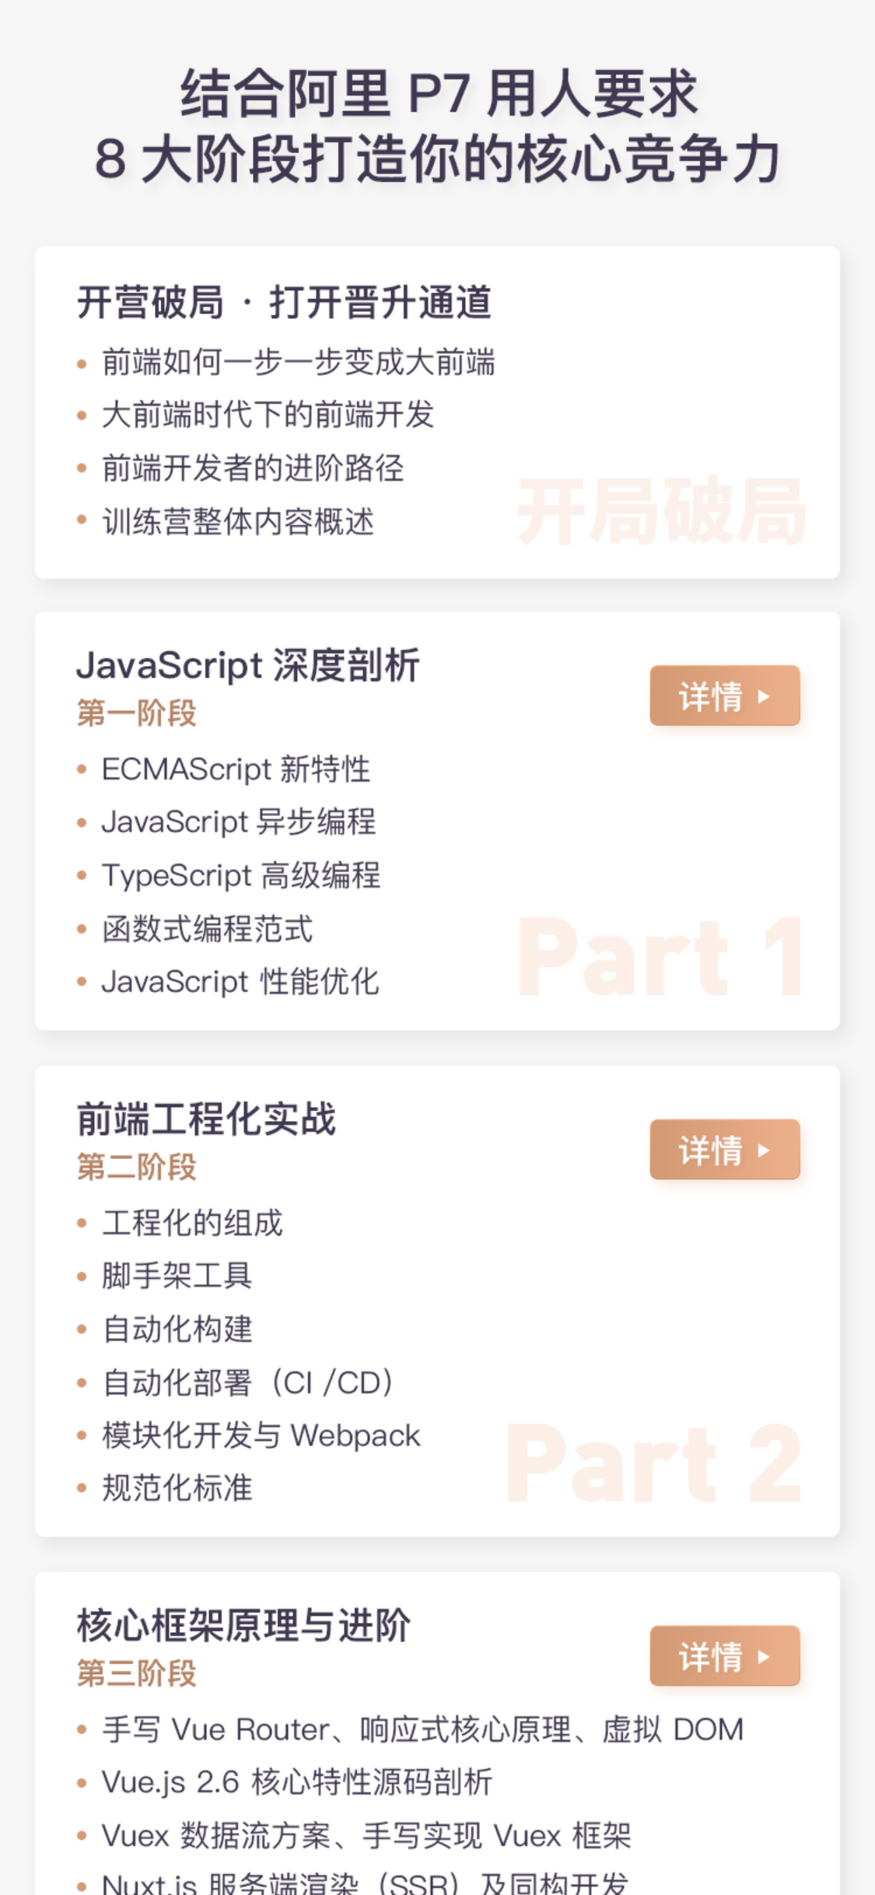
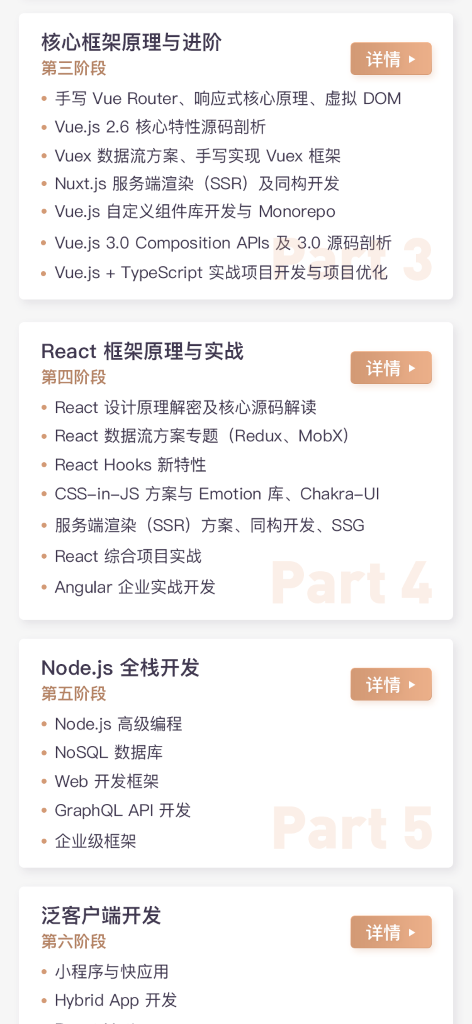
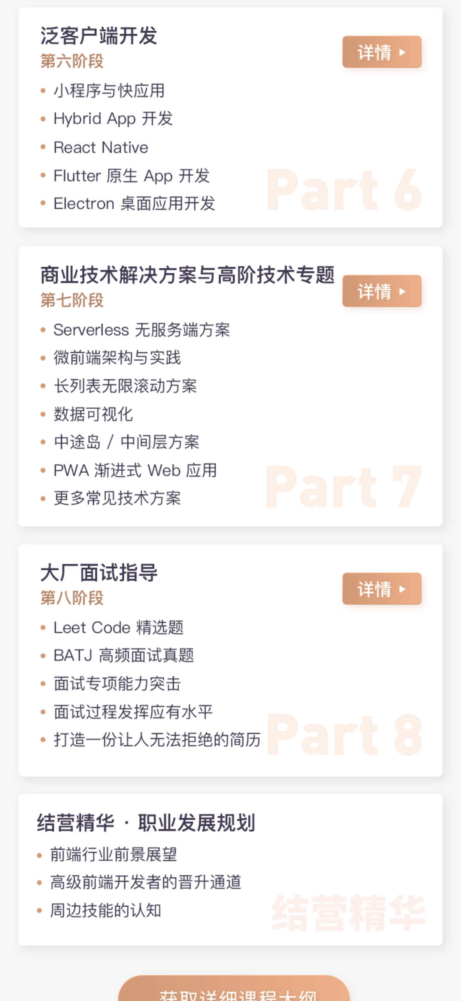

Slide 128
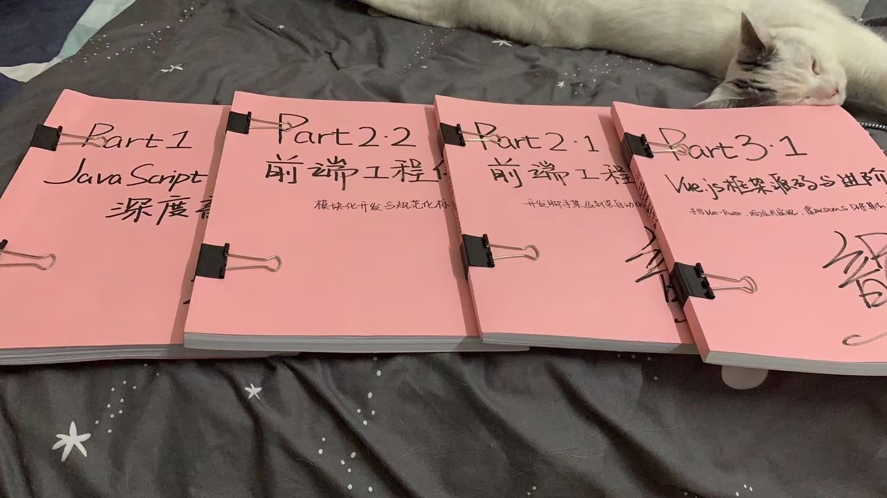

Slide 129
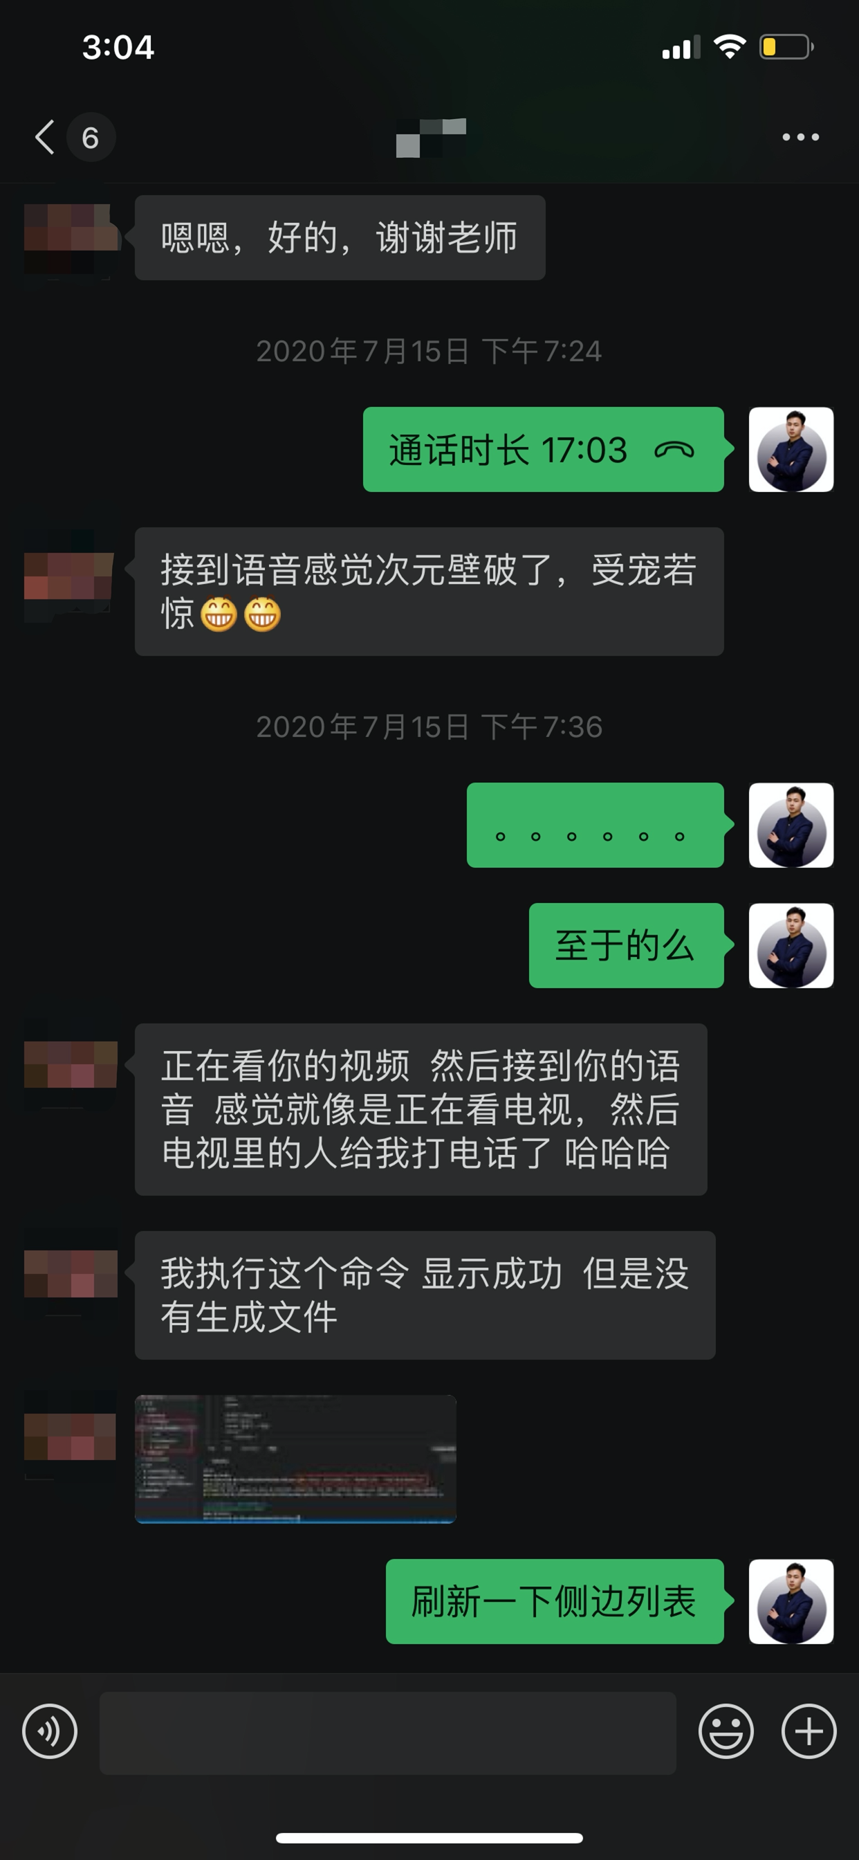
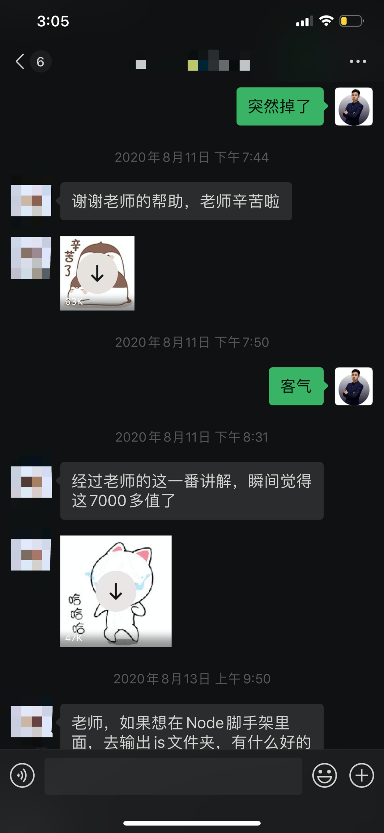
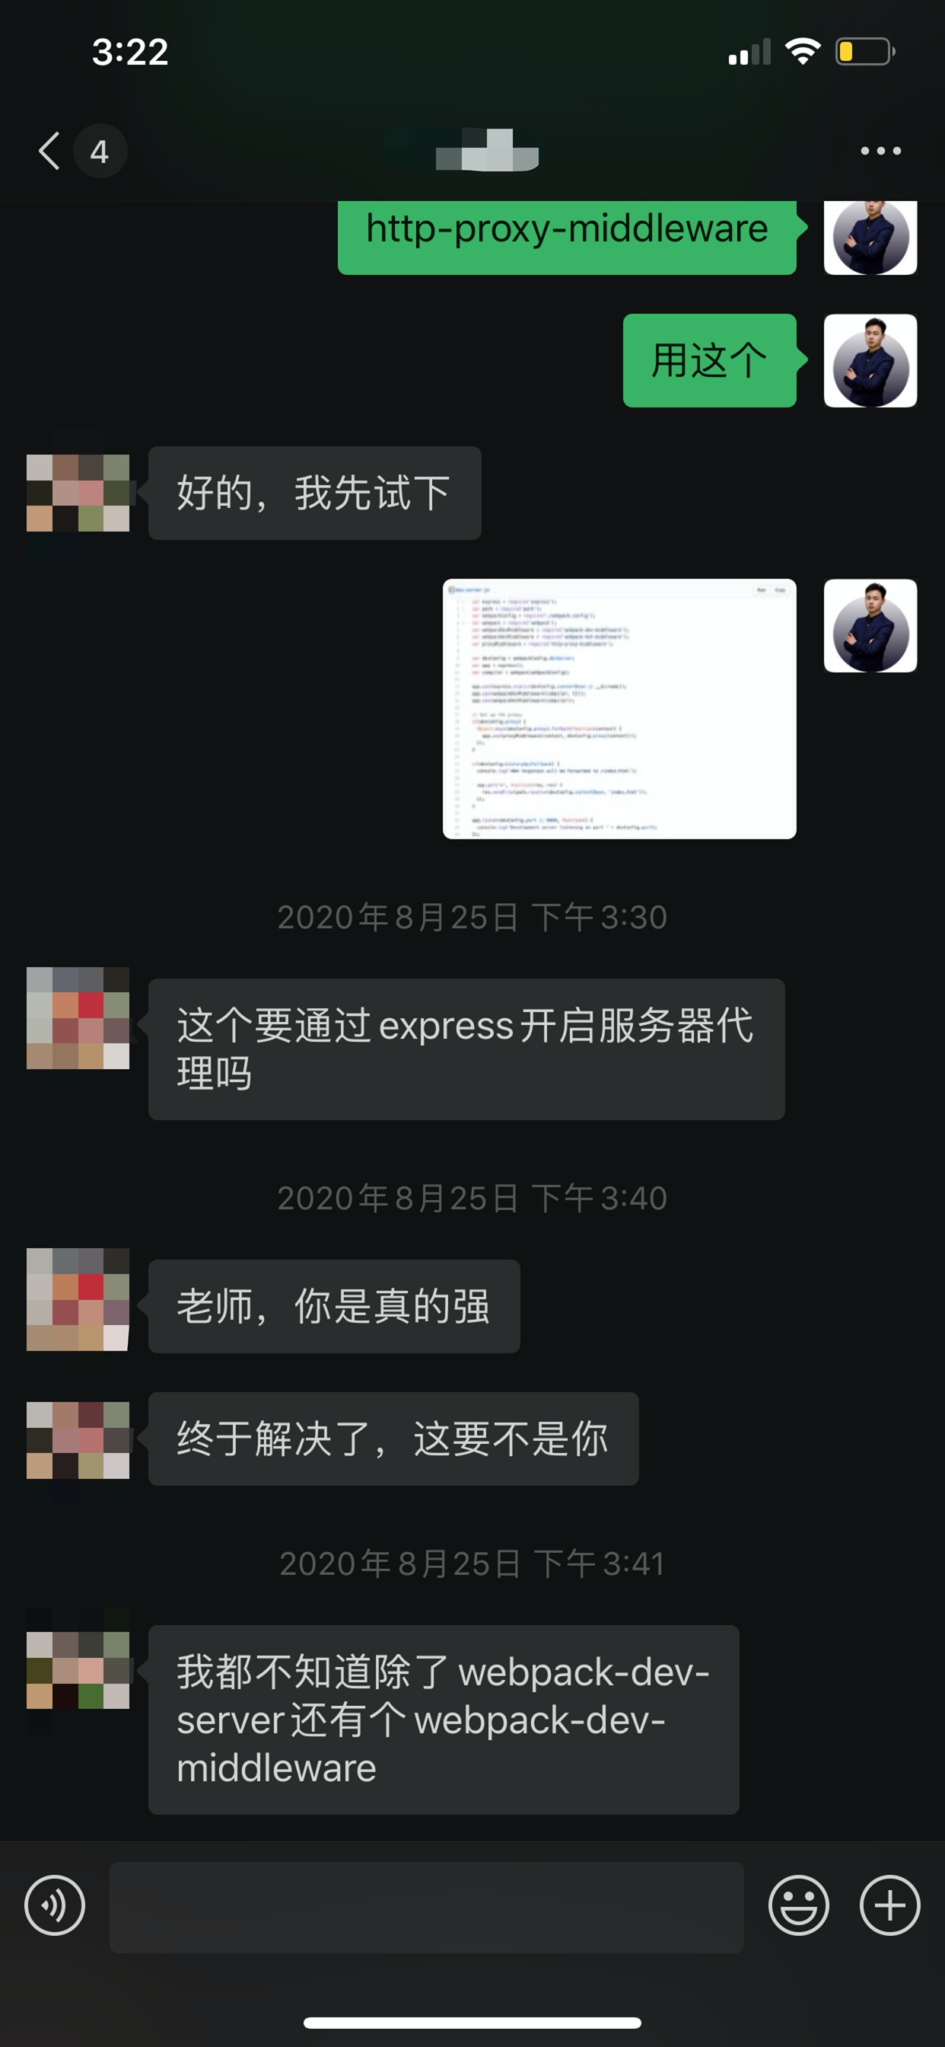
1v1 电话 / 语音指导

Slide 130
随堂测试 & 模块作业

Slide 131
作业 1v1 返修

Slide 132
日常社群答疑

Slide 133
班主任 7*24 全方位关怀与监督

Slide 134
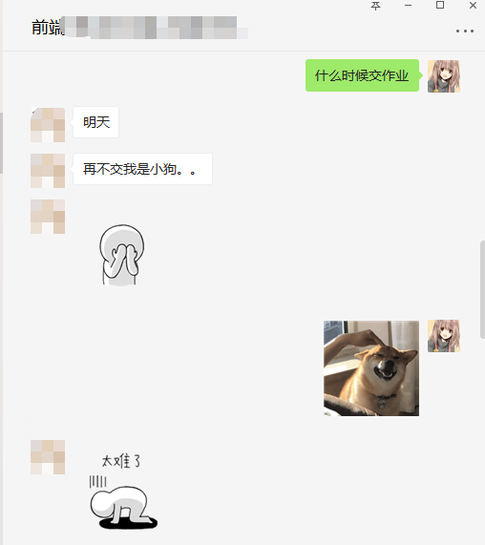
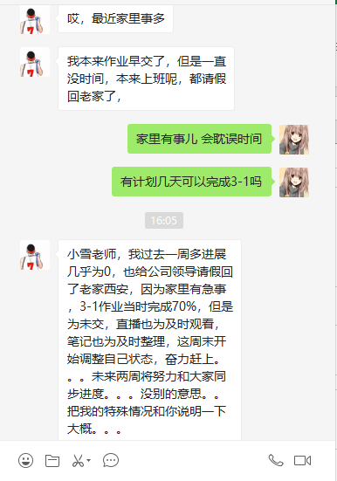
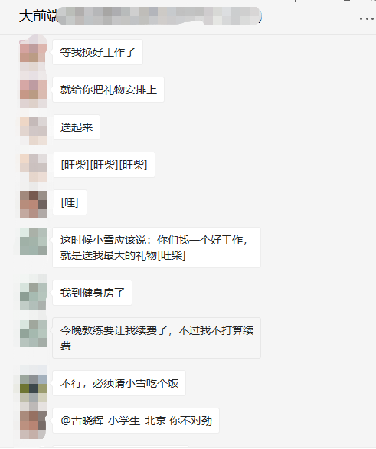
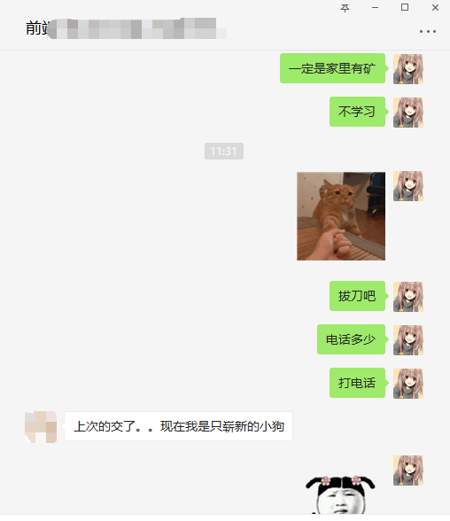
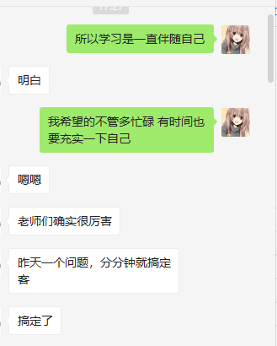
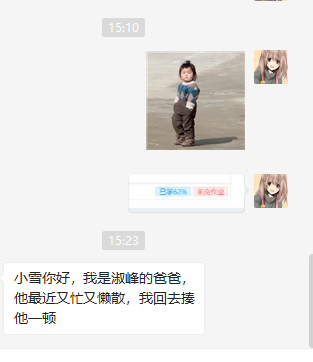
班主任 7*24 全方位关怀与监督

Slide 136








行不行看结果！！！

Slide 137
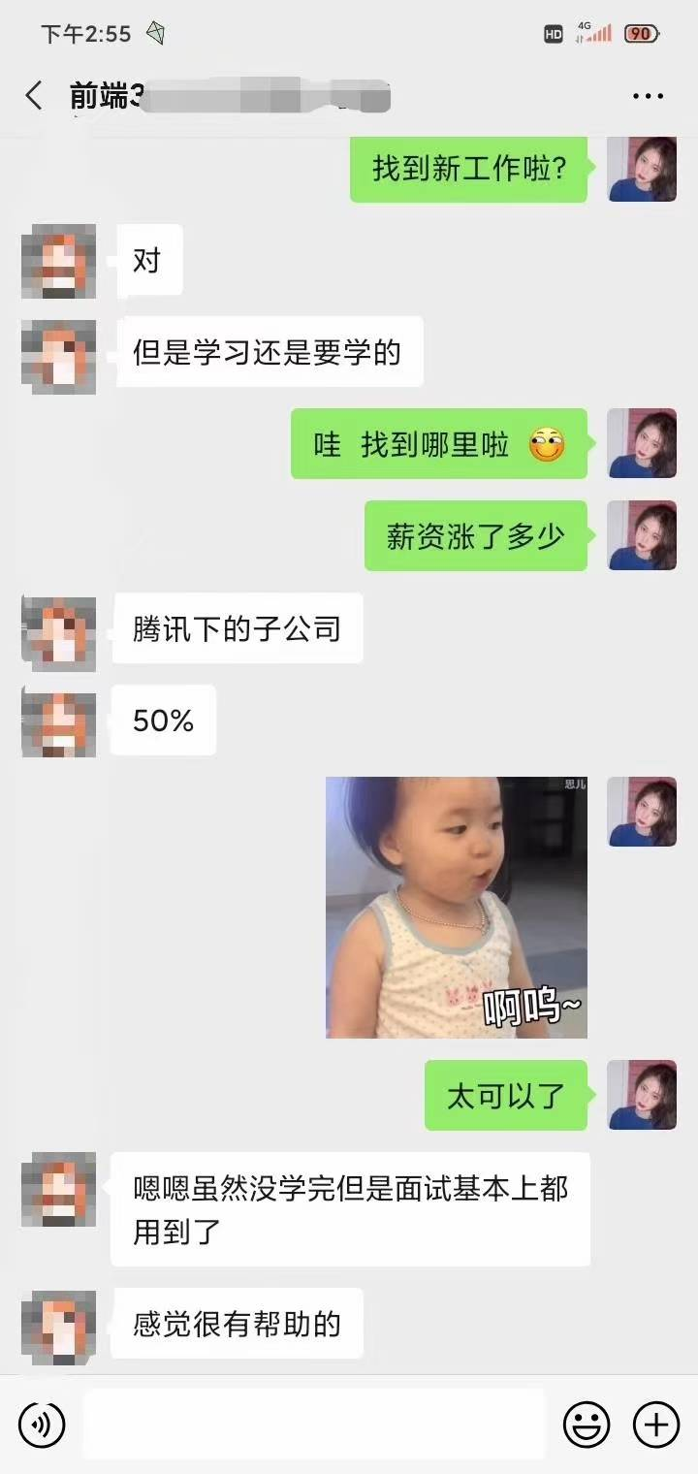
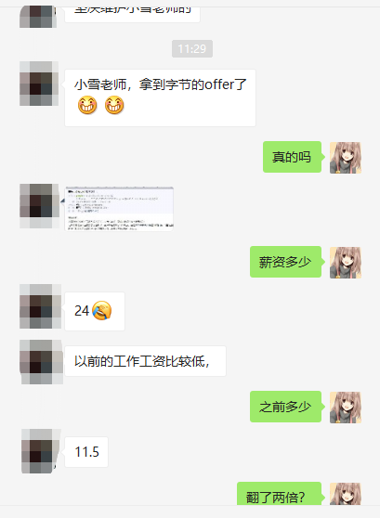
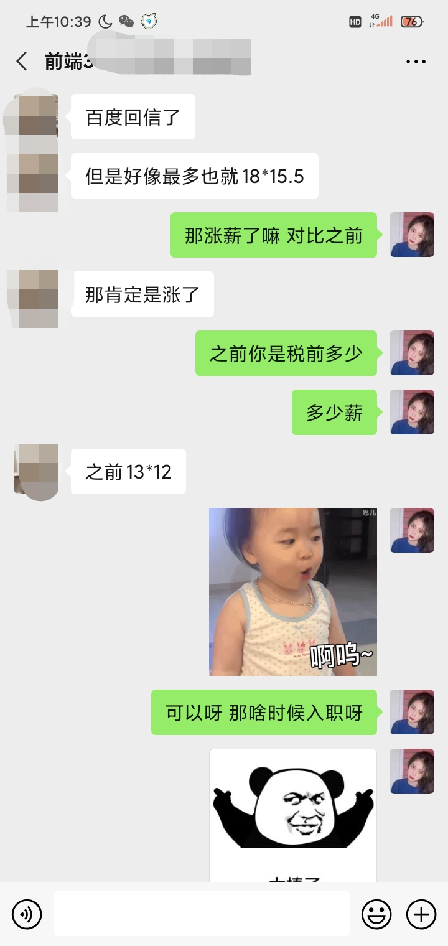
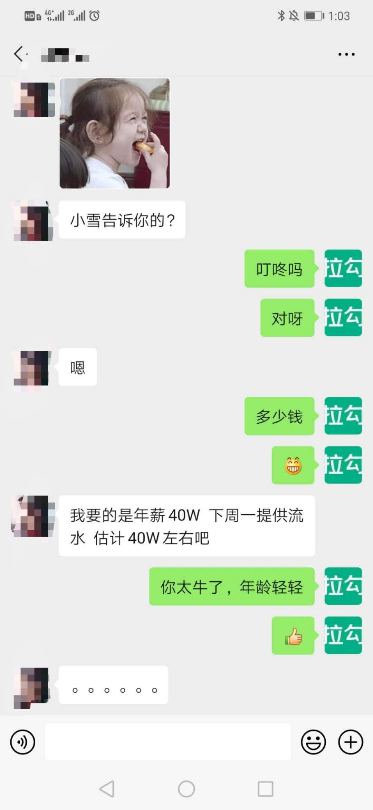
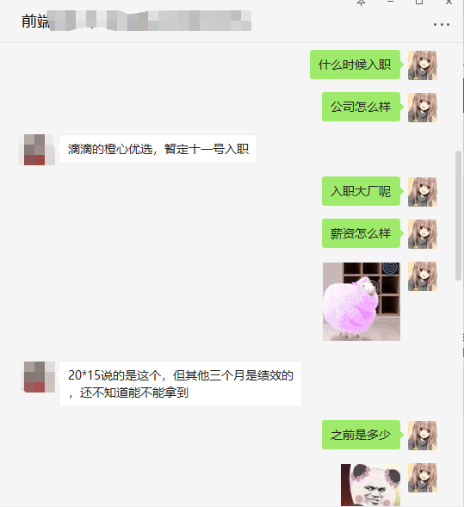




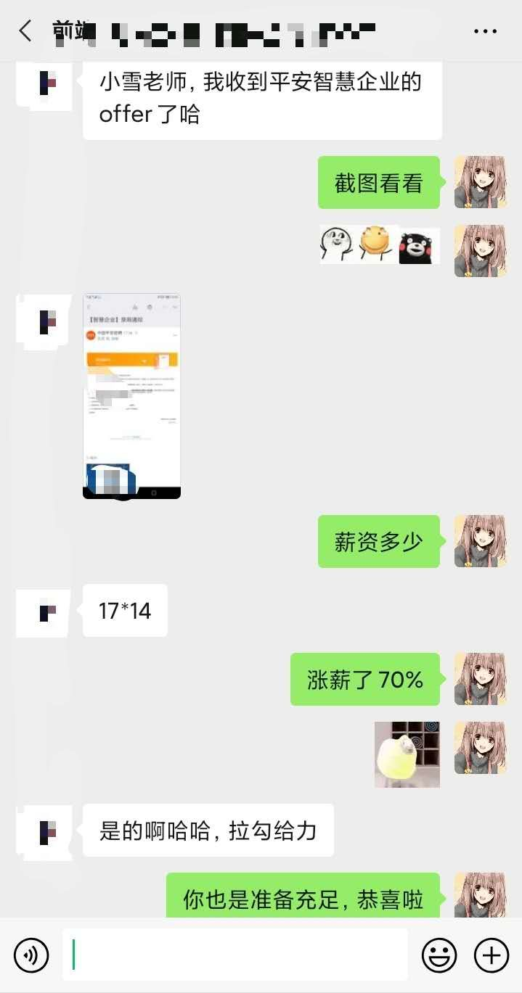
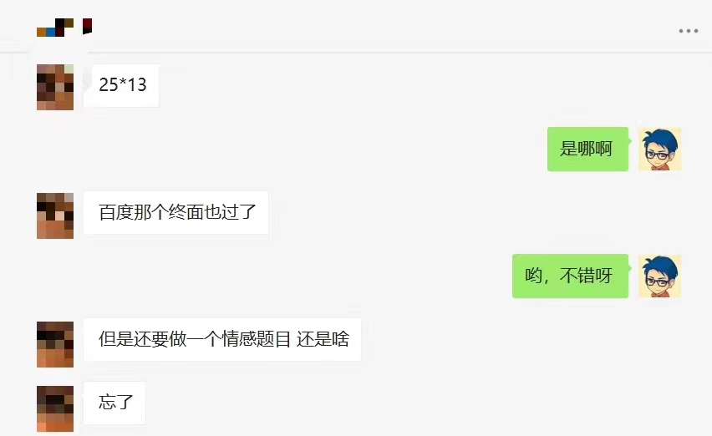
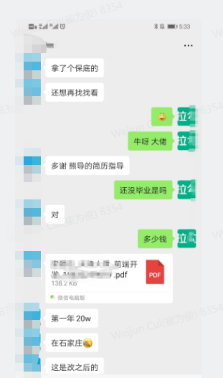

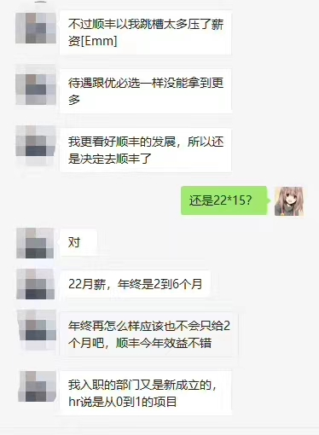


Slide 138
学员遍布一线大厂

Slide 139
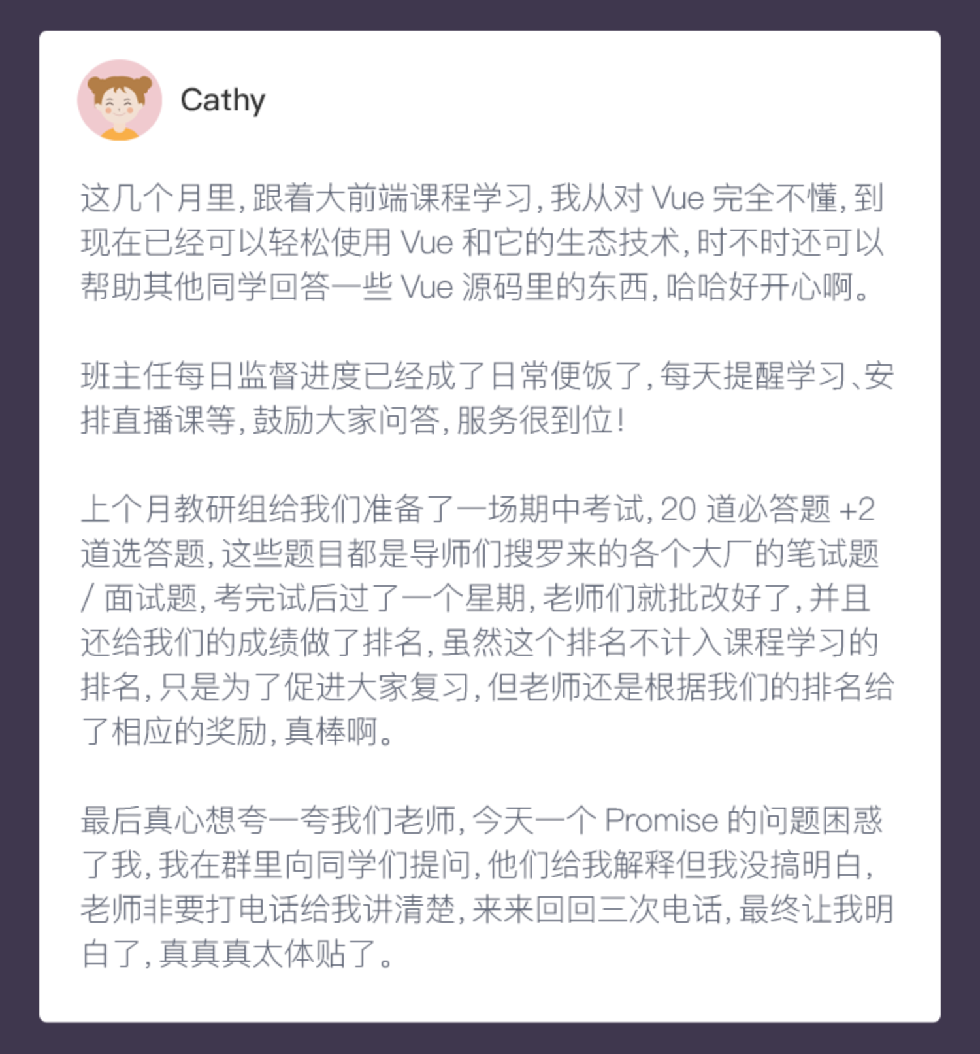
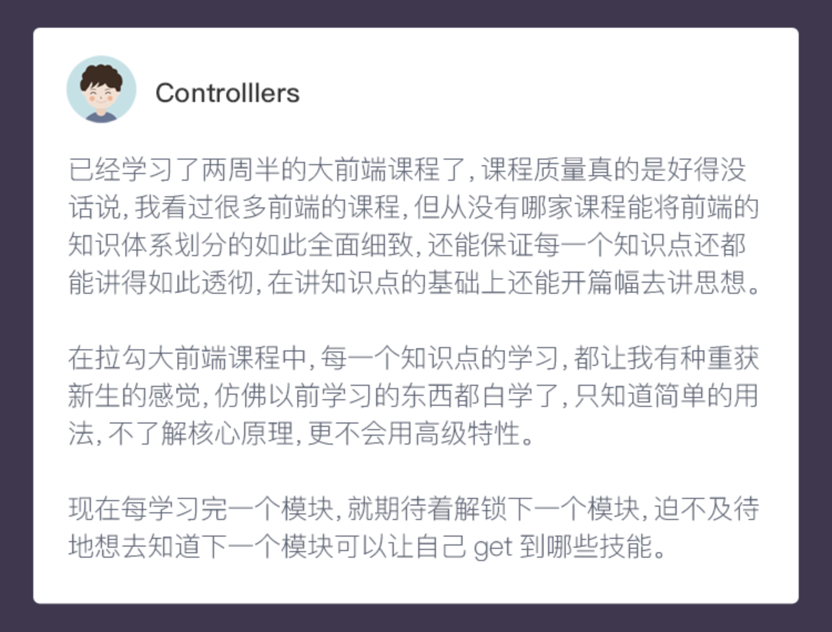
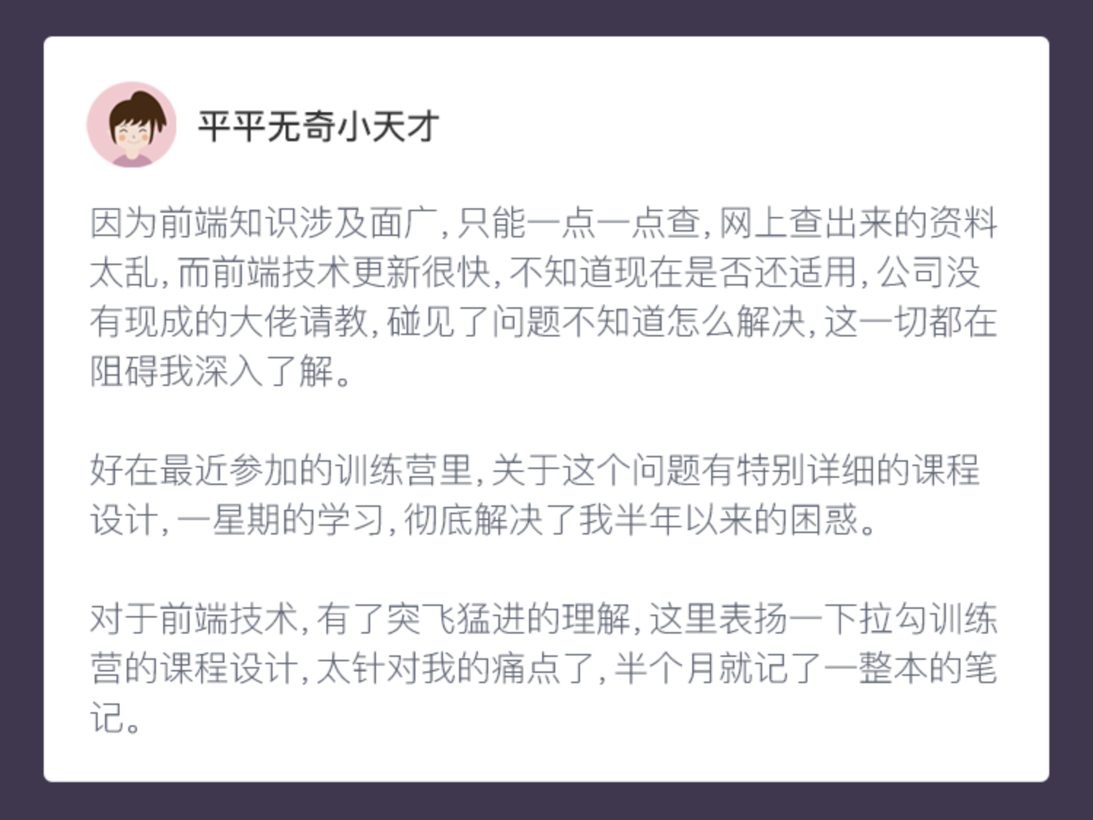
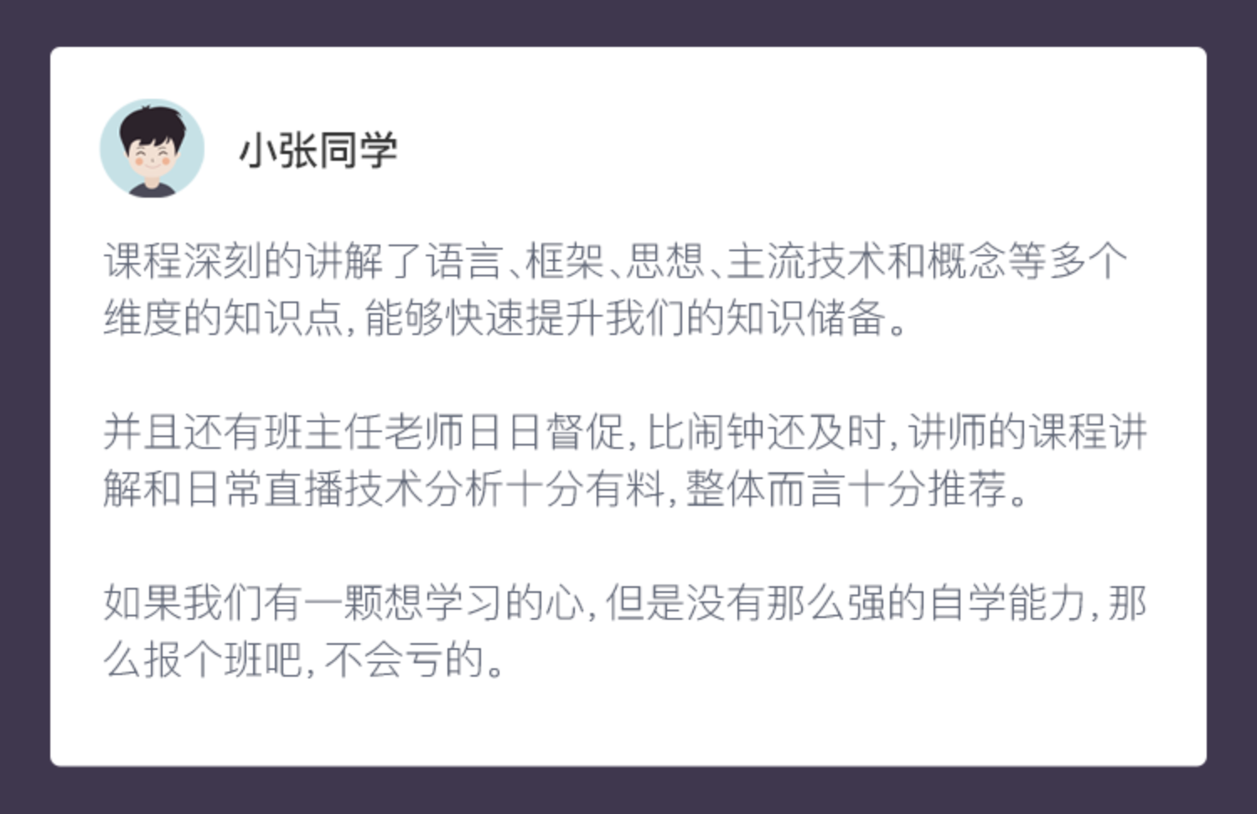
看看师兄师姐怎么说

Slide 140

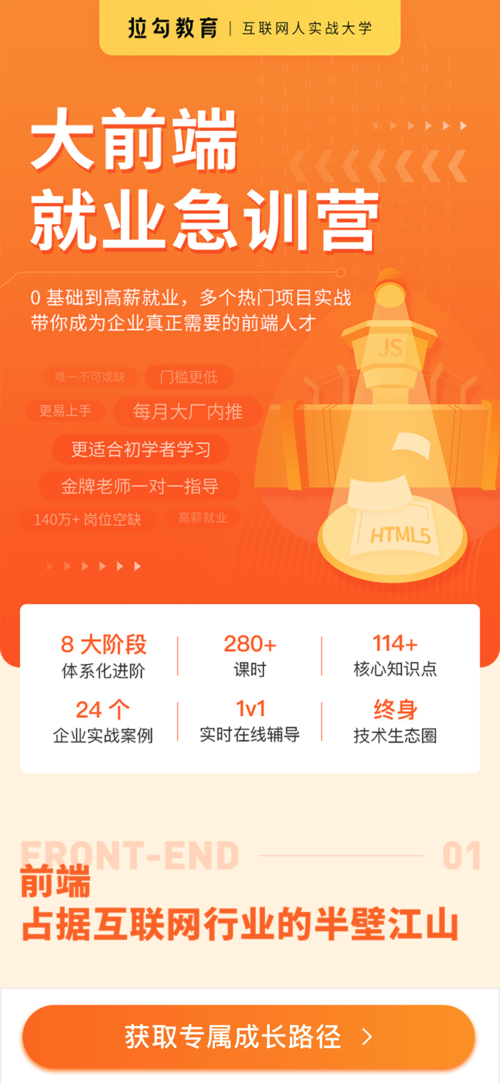
大前端高薪训练营
12 月 28 日 正式开营
最后 4 小时！
直播福利 12 个试学名额
赠送价值 ¥688 拉勾教育 VIP 年卡

Slide 141
常见问题
我对课程大纲中一些内容已经掌握了，不想买整套
我已经买了书/视频正在自学，还有必要报班吗？
目前离职，想找到工作再学习
太忙了，天天加班怎么办？996 怎么安排时间呢？
项目案例是什么呢？学完了就能上手吗？
基础薄弱，怕自己学不会怎么办呢？0 基础的？
Notes:
1
我们产品并不是要给你传递一堆的知识点，而是帮你得到系统化、体系化的提升，你应该理解为一套有结构的在职提升解决方案，他是结果导向的。
我可以给你打个比方，郭德纲大家肯定都知道，好多人都说郭德纲是运营鬼才，大家有人知道么？
早前有个对郭德纲的采访，他在里面聊了很多，一个猴有一个猴的栓法，
那跟我们这个大前端高薪训练营有什么关系呢？https://3g.163.com/v/video/VU4I9AMFP.html
很简单，我们不只是要教你一堆技术，我们是要带你突破现在的瓶颈，课程只是这个过程中我们使用的一个很重要的工具罢了。
你想想，我们为什么要配那么多讲师、导师、就业顾问、班主任，甚至还会不定期的找一些目前还在企业中从事一线开发的大咖给你做直播分享？
课程其实并不值钱，真正成本高的的是后面这些服务。而且只有这些配合起来才能解决你的问题。
当然，咱们直播间里还有好几个已经报名的同学，我也想跟你们说一下，只要你够努力，配合我们的各种安排，咱们一定会冲出来的。
那针对这个问题，我就说这么多，你们自己想想就明白了。
2.
第二个问题其实跟第一个问题类似，我就不啰嗦什么了，当然除了结果导向，
还有个很重要的点，因为我们高薪课程只招有经验的同学，所以一帮有经验的人一起，而且不像公司里的同事，大家都不会有什么利益关系，一块聊聊技术什么的，还有以后长期的人脉。以后再跳个槽、招个人什么的。。。
3.
无论你现在是什么状态，都应该持续学习，我们只是提供你一个更有结果的 offer 而已
4.
关于忙，没时间的问题，我想说
录播
5.
项目这块，小型项目不算，目前有三套业务，共计5个大型项目，
在线教育
2. 使用 React 全套技术栈配合服务端渲染的在线教育 PC 端 Web
3. 使用 Flutter 开发的在线教育移动 App
管理系统
3. 使用 Vue.js 全家桶开发的电商管理平台项目
电商业务
1. 使用 Node.js 中间层方案开发的电商 PC 门户
2. 使用 uniapp 开发的跨平台小程序项目
可能有人说，你这个项目没啥特别的，我想说的是项目的牛不牛逼并不是看业务，而是看技术和解决方案的运用。
其次拉勾这边本来就是一家互联网技术公司，我们的研发团队也有 100 多人，我们每个项目都是教学侧与技术团队合力打造的。

